Slide 1

React and Flux From Scratch
Go here and get setup!
github.com/coryhouse/fluent2016
Finished demo:
github.com/coryhouse/fluent2016complete
Cory House
@housecor | bitnative.com
Notes:
Hi, I’m Cory House, and welcome to Building Applications with React and Flux. In this course we’ll explore how to build a single page application using real-world tooling and configuration. We’ll use a variety of technologies including Browserify, Gulp, and Node.js. And to keep things interesting, the application we’re creating will be a web app for administering Pluralsight authors and courses. We’ll decompose the application into multiple nested components using React, we’ll handle client-side routing via React Router, and we’ll create unidirectional data flows using Flux.

Slide 2
Questions:
Plan to code along with me?
Focus: Code or concepts?
Atom or Webstorm?
Light or dark theme?
Breaks?
Notes:
Slides if time or code if time?

Slide 3
git clone https://github.com/coryhouse/fluent2016.git
To code along with me:
Notes:
Or, local: http://172.23.0.9/fluent

Slide 4
Start github.com/coryhouse/fluent2016
Finish github.com/coryhouse/fluent2016complete
Code snippets bit.ly/fluent2016reactplan
Notes:
Backup: http://172.23.0.9/fluent

Slide 5











A World of Components
Notes:
These days there is a wide variety of ways to create rich web applications using components.
You can buy off the shelf components from Telerik like KendoUI.
You can use open source components like jQueryUI.
Knockout offers components.
Ember offers components.
Angular has its own model for components that it calls directives.
And there are even native web components that follow a new emerging standard which I covered in a separate Pluralsight course.
Now, given some of these are pure component libraries, while others listed here are full fledged application frameworks. But the point is, each offers a unique way to handle web components.
We have a vast list of options for creating component-based UIs for the web today. And React is yet another option. So what makes React special? Why should you choose it over all these other options? Let’s consider what unique qualities React has to offer:

Slide 6
They call it React for a reason.
Notes:
However, let me warn you, I like to joke that Facebook called it React for a reason.

Slide 7
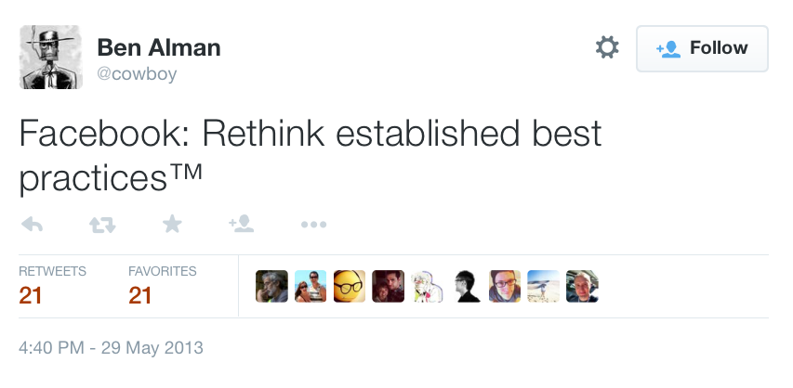
Notes:
Add https://twitter.com/cowboy/status/339858717451362304
React takes all sorts of existing best practices, and deliberately ignores them. So if you’ve never seen React and Flux, I’m going to have to ask you to keep an open mind. To try to limit your initial urge to vomit in your mouth or rage quit and run out the door.
Because trust me, all best practices should be questioned from time to time. Our industry moves so fast it would be silly for us to blindly continue to blindly follow the same paths. If you’re willing to listen with an open mind today, I hope I can sell you on rethinking the way you’re doing front end development.

Slide 8
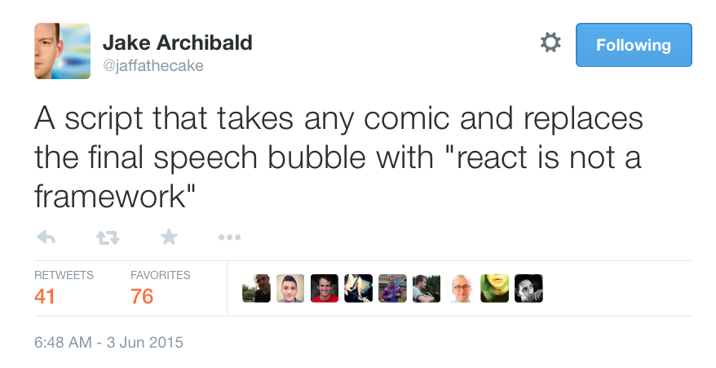
Notes:
React is not a framework meme here
Angular is so tired of the comparisons that they’re starting meme’s like this.
https://twitter.com/jaffathecake/status/606064895805792256

Slide 9
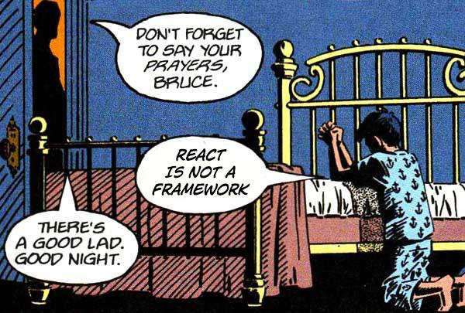

Slide 10
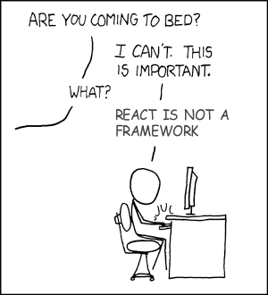

Slide 11
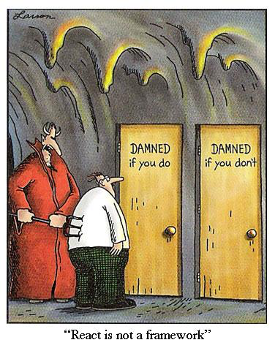

Slide 12

Innovation
JSX
Virtual DOM
Isomorphic Rendering
Unidirectional Flows
Notes:
As you’ll see in this course, React and Flux offer a number of interesting innovations including
JSX, which involves writing your markup in JavaScript.
Virtual DOM – Which enhances performance and efficiency by minimizing expensive updates to the DOM.
Isomorphic Rendering – Which allows you to render your React components on both the client and the server
And Unidirectional Data flows which makes your application easier to reason about by handling all data flows in a predictable flow by using a centralized dispatcher.
Now to clarify, I’m not claiming that React and Flux are the first libraries to utilize all these patterns and technologies, but React and Flux are the first libraries to rich critical mass and help bring these approaches to the forefront.

Slide 13
Try to keep an open mind.
Notes:
I believe common practices should be questioned from time to time. Our industry moves so fast it would be silly for us to blindly continue to follow the same path. If you’re willing to listen with an open mind today, I hope I can sell you on rethinking the way you’re doing front end development. Here’s a few controversial ideas that we’re going to cover in this course.

Slide 14
HTML should be a projection of app state, not a source of truth.
Notes:
First, React takes the stance that HTML should be a projection of application state, not a source of truth. Just think about how the jQuery caused us to make this mistake for years. We stored data in the dom and data in JS. At any given point, which was the system of record? Anytime the JS changed, ALL the UI had to be redrawn.
React’s virtual DOM changes how you think about your app. Your app is a function of props and state. You don’t store anything in the DOM, it is simply an implementation detail (as React-Native demonstrates).
From What's wrong with AngularJS https://medium.com/este-js-framework/whats-wrong-with-angular-js-97b0a787f903

Slide 15
JavaScript and HTML belong in the same file.
Notes:
Second, as you’ll see, React takes the stance that JavaScript and HTML belong in the same file. For years we’ve talked about separation of concerns as a common best practice. But is separation of concerns always a good thing? What if they’re completely intertwined and there’s no strongly typed explicit interface to keep them in sync? As you’ll see, there’s some clear benefits to placing them in the same file.

Slide 16
Unidirectional flow. No two-way binding.
Notes:
As we move on to Flux, we’ll see that there are some advantages to unidirectional data flow as opposed to the two-way binding that you’re likely used to if you’ve worked in Angular, Ember, or Knockout. Unidirectional flows will make our application easier to reason about and will offer us a simple path toward updating our data stores as application data changes.

Slide 17
Inline styles can be good.
Notes:
Now this sounds crazy, but when using React, inline styles are actually useful again and can actually increase code maintainability by avoiding the creation of bloated style sheets that are very risky to change. React components allow you to utilize the power of JavaScript to write dynamic, deterministic, and component specific styles that are potentially easier to maintain than traditional stylesheets.
Inline Styles Are Good
From https://medium.com/javascript-scene/jsx-looks-like-an-abomination-1c1ec351a918
I struggled with this at first. I was all-in on the idea of CSS, but in practice, CSS has failed in a lot of ways. First, it’s essentially a global playground, and CSS selections often overlap in undesirable ways and create awkward side-effects, which leads you to get more specific with the selector, which in turn makes your CSS selections more brittle, so they break when the DOM changes.
Putting styles in a React component is more akin to putting styles in a web component than putting styles into raw HTML. If you did it in raw HTML and you wanted to change the look of a buy button, and you have 10k items, you’d need to update the style in 10k places.
Components don’t work that way. Since the style is in the reusable component, you only have to update it in one place, and you don’t have to worry about selector scoping.
As a bonus, you also get style variables, style modules, style inheritance, and a number of other things you’re already using a preprocessor for — but now you don’t have to learn a whole new syntax. You do it in JS.
I thought I’d hate it, but I love it.

Slide 18
All Variables Should be Global.
Notes:
And brace yourself, because we’ve entered a new era: In React, all variables should be global. Global variables are awesome!
Okay, I’m kidding! This was totally a test to make sure you’re paying attention. Hopefully you didn’t just rage quit and turn off the course. In actuality, React with Flux does an excellent job of encapsulating and managing state. But the other previous points I just mentioned are indeed legitimate arguments that I’m going to make throughout this course.

Slide 19













Battle Proven
Notes:
And while these ideas may be controversial, many well respected companies have already embraced React and are using it on large scale production systems. Not just Facebook, but many names you’d recognize like Paypal, Dropbox, Netflix, and Yahoo.
So React may be new to you, but its actually a battle proven library that’s been used in production since 2013.

Slide 20
Here’s the Plan
9:00 - 9:15 Intro and Environment Setup
9:15 - 9:45 JSX and Virtual DOM
9:45 - 10:30 Code: Creating Components
10:30 – 11:00 Break
10:30 – 10:45 React Lifecycle and Composition
10:45 – 11:15 Code: React Lifecycle and Composition
11:15 - 11:40 Flux Intro
11:40 - 12:15 Code: Flux
12:15 - 12:30 Wrap up

Slide 21
Environment Setup

Slide 22
github.com/coryhouse/fluent2016
Everyone done this?

Slide 23
Don’t Let This Scare You…
You don’t need all this tech to work with React and Flux.
Notes:
Before I move forward and start walking through the configuration for our development environment, I want to clarify that all of this technology isn’t required for building applications in React and Flux. In fact, most of what we’re going to setup here isn’t specific to React and Flux at all. What this module is about is creating a dev environment that gives us rapid feedback as we build our application. So these tools are useful for anyone building apps in JavaScript. So with that warning out of the way, let’s move forward.

Slide 24
Our Goal
Just type “npm start”, get all this…
Compile React JSX
Lint JSX and JS via ESLint
Bundle JS and CSS files
Migrate the built app to the dist folder
Run a dev webserver
Open the browser at your dev URL
Reload the browser upon save
Notes:
By the end of this module, we’ll have a really slick development experience. All you’ll have to do is type Gulp and all this magic will happen:
Compile React JSX
Lint JSX and JS via ESLint
Bundle JS and CSS files
Migrate the built app to the dist folder
Run a dev webserver
Open the browser at your dev URL
Reload the browser upon save
Once you’ve done development with all this modern tooling, you’ll never go back.

Slide 25






Core Technologies
Server-side JavaScript
Node packages in the browser
Components
Routing
Unidirectional data flows
Task runner
Notes:
Let’s walk through the core technologies we’ll use to build our app.
We’ll use Node to run server-side JavaScript
We’ll use Browserify to expose these Node packages to the browser
Of course, React will be our components library
We’ll use React Router to handle client-side routing
We’ll use Facebook’s Flux to handle our application’s data flows.
Finally, we’ll use Gulp as the task runner that wires all of this together in an easy to use script.
So this the technology stack that we’ll explore throughout this course. Let’s discuss each of these technologies in a bit more detail.

Slide 26
Node
Server-side JS
Uses the V8 Engine
Includes npm package manager
Notes:
Building an app with React and Flux doesn’t require using Node, but Node helps make our job easier. Node runs JavaScript on the server using Google’s fast V8 engine. Node now includes npm, which is Node’s package manager. Npm includes 1000’s of useful JavaScript libraries. So we’ll use npm to pull down the libraries we need for our project. If you haven’t used Node, don’t worry, we’ll walk through the basics of what you need to know to get going in this course. But if you want to learn more, there are a number of courses on Node here on Pluralsight.

Slide 27







npm: Node’s Package Manager
.NET
Ruby
Java
Python
PHP
The Web
Node
Notes:
As I said on the previous slide, Node comes bundled with its own package manager called npm. Npm is how we’ll install and manage the dependences we need to run our app. You’re likely already familiar with the concept of a package manager if you code in a server-side language.
.NET developers use Nuget
Ruby has Rubygems
Java has Maven
Python has PIP
PHP has Pear
And front-end developers often use Bower to manage packages related to HTML, JavaScript, CSS, and other things web related.
Npm is Node’s package manager. It provides a quick, easy way to install node packages. One you’ve installed Node, you simply type npm and the name of the package you’d like to install.

Slide 28
CommonJS Pattern
//1. Get reference to dependency
var dependency = require('/path/to/file');
//2. Declare module
var MyModule = {
//code here…
}
//3. Expose to others
module.exports = MyModule;
Notes:
Node uses the CommonJS pattern for referencing and exporting modules. You might be familiar with alternatives like RequireJS’s Asynchronous Module Definition pattern, also known as AMD. Node’s CommonJS pattern serves the same general purpose of encapsulating your JavaScript into a reusable module that can be referenced by other modules. However, it’s simply a different syntax. In short, using the CommonJS pattern consists of three core parts:
1. First, you reference any modules you want to use using the require function. You pass the path of the module you’d like to import. If the module is in your node_modules folder, you don’t need to specify a path since Node will check there automatically.
2. Second, you declare you module itself. You write all your code within this module.
3. And finally, at the bottom of the file, you export the module you just defined. This exposes your module so that other modules can use this module using the require statement. We’ll build all our JavaScript files using this CommonJS pattern.

Slide 29
Browserify
Use Node modules in the browser
Bundle dependencies
Notes:
There are a variety of patterns and tools for managing and bundling dependencies in JavaScript. RequireJS is a popular choice, but Browserify has become increasingly popular because it bundles up Node modules so that you can use them in the browser. And that’s really handy because npm has 1000’s of useful JavaScript libraries. So it’s great by simply using Browserify all of npm’s packages can now be easily used in the browser. By default, Browserify bundles all your dependencies into a single file.
Note, Webpack is a popular alternative. For info on choosing between the two: https://github.com/kriasoft/react-starter-kit/issues/3
Steps to setup demo: (likely move this to a separate slide)
npm install –g browserify
Create directory to house the test project
Install a 3rd party dependency like lodash: npm install –save-dev lodash
Create a js file that requires lodash, then reference that file in index.html
Run browserify scripts/main.js > bundle.js. Browserify will bundle the node modules and your code into a single js file that the browser can consume.
Note how I can use –d to generate with sourcemaps to support debugging. Then can set breakpoints in the files. But also note how 333k of JS became 950k, so only want to do in dev.
But what if we want browserify to re-run anytime we save a file? Then use watchify instead. It takes the same params as browserify, but watches your files too. So:
Npm install –save-dev watchify
But what if I want to run it as part of on ongoing build process via Gulp or Grunt? Well, let’s set that up using Gulp.
First, install Gulp: npm install –g gulp
So how does Browserify work? It simply looks through each of the files that match the glob that you specify. For every require() call with a string in it, browserify resolves those module strings to file paths and then searches those file paths for require() calls recursively until the entire dependency graph is visited. Each file is concatenated into a single javascript file with a minimal require() definition that maps the statically-resolved names to internal IDs.
This means that the bundle you generate is completely self-contained and has everything your application needs to work.
Now note, Browserify isn’t the only module loader option out there. There’s also currently RequireJS, WebPack, SystemJS, and JSPM. But the reason I’m choosing Browserify is because it has a very focused mission: Make npm modules work in the browser. This is exactly what we need for an isomorphic app, because we need to assure that the module loader and packages we choose run on both the client and the server. If we were doing only traditional client-side rendering, then RequireJS is a popular choice.

Slide 30

React
Component Library
Simple composition
Utilizes virtual DOM
Can render on client and server
Notes:
For our component library, we’re going to use React. React is a project from Facebook that handles a very specific set of concerns: packaging, composing, and rendering HTML components.
Because of this focus, React is lightweight and makes it easy to create complex Uis by composing many simple components together. Because React is so focused on this one goal, it can even be used along with other frameworks like Angular and Backbone.
React utilizes a virtual DOM, which makes it very fast. When the UI changes, React compares the old state to the new state in memory and then updates the DOM in the least expensive way. This saves resources and makes React notably faster than many of today’s popular alternatives.
And with the power of the virtual DOM, React can even support rendering on both the client and the server. This of course is critical for building isomorphic apps, and really sets React apart from other traditional libraries and frameworks that are currently very DOM oriented like Angular and Knockout.

Slide 31

Flux
Uni-directional data flows
More a pattern than a library
Notes:
Flux is a unidirectional data flow library created by Facebook to complement React. Flux is really just a branding name for Facebook’s implementation of a unidirectional data flow pattern. There are a variety of alternatives including Delorean, Fluxxor, Fluxxy, and Reflux, but we’re going to use Facebook’s Flux implementation in this course.
Flux avoids a more traditional MVC style pattern and instead implements one way data flows. This tends to make large applications easier to predict and reason about by avoiding complex interactions that can occur between multiple view and viewmodels in traditional MVC.

Slide 32
Gulp
Task runner
Rich plugin ecosystem
Stream-based
Notes:
To tie all this together, we’ll use Gulp. Gulp is a popular JavaScript based task runner. Grunt is a popular competitor that would work just fine for our purposes as well, though Gulp has recently gained a great deal of popularity because it’s easy to configure and very fast.
Gulp has a rich plugin ecosystem that allows us to easily automate all sorts of important tasks like minification, linting, bundling, moving files, running tests, and watching files so your browser automatically reloads when you save file changes.
Gulp is fast because it’s stream based. Gulp allows you to glue a number of tasks together by taking the output from one plugin and uses that output as input for the next plugin. Keeping all the work in memory rather than writing to disk is what makes Gulp so much faster than its current primary competitor, Grunt.
Gulp can perform 100’s of different tasks. Our primary use when building our example app is to watch files and run the Watchify plugin. This plugin will automatically bundle our code using Browserify as changes are made to the solution.
Again, to clarify, you don’t have to use Gulp, Browerserify, or Node to build applications with React and Flux. But as you’ll see, these tools help streamline the process.

Slide 33
What about ES2015?
ES5
ES2015 (ES6)
Approved in 2009
The JS you already know
Excellent browser support
Approved June 2015
Browser support is growing
Can transpile to ES5 via Babel
We’re using ES5 in this course.
Notes:
“I was torn on whether to use the brand new version of JavaScript, ECMAScript 2015, more commonly referred to as ES6, in this course. ES2015 was officially ratified June 2015.
In contrast, the JavaScript we’ve been using for years has been around in its current version, ES5, since 2009. So ES5 is the JavaScript you’ve been writing for years. And that’s why I decided to stick with ES5 for this course. I don’t want to alienate people who aren’t yet up to speed on the latest version of JavaScript. As you review other examples of React online, you may see some in ES2015, and some in ES5. ES2015 is certainly the future, but to avoid confusion, I use ES5 in this course - the version of JavaScript that you’ve been familiar with for years.

Slide 34
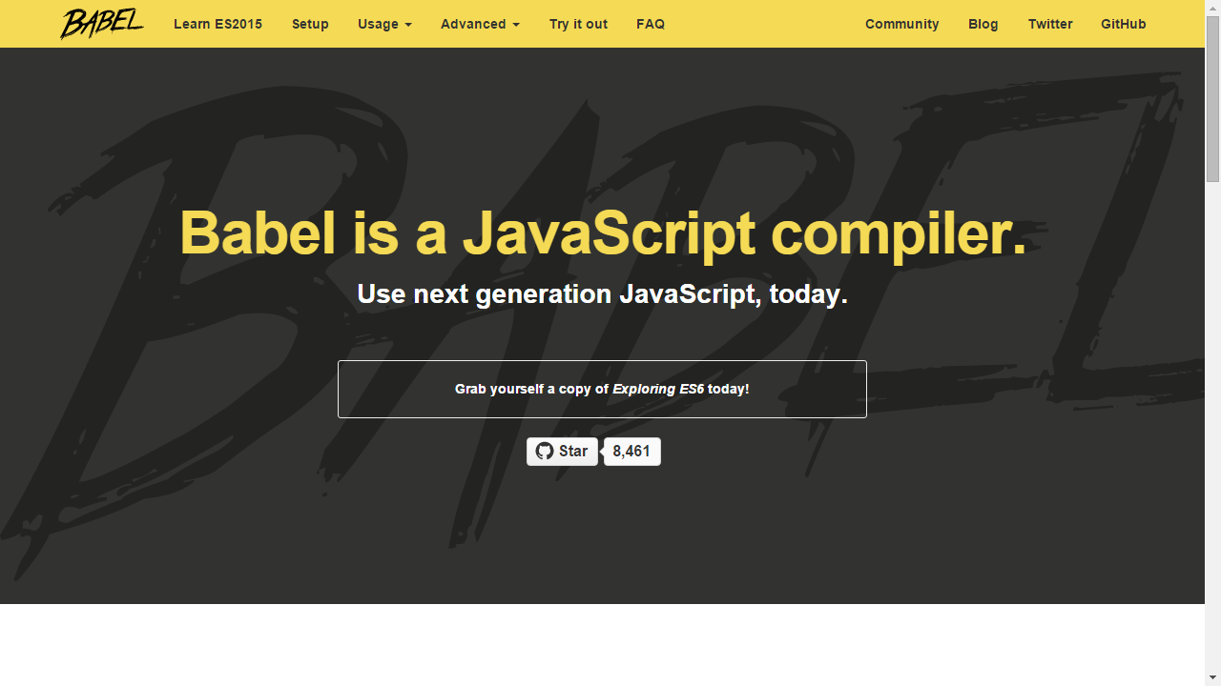
What about ES2015?
Notes:
That said, I strongly recommend checking out ES6 and transpiling via Babel. It’s a great way to enjoy the newest version of JavaScript today.

Slide 35
Versions
React 0.14.7
Flux 2.0.3
Notes:
One quick note before we dive in and install these final libraries. As we just saw, the technologies in this course are proven and used on some of the largest websites in the world such as Facebook and Yahoo. However, at the time of this recording, React and React-router haven’t yet reached a 1.0 release, so their APIs may make breaking changes from what you see in this course. I’ll do my best to keep this course updated, but to assure that you can follow along, I’m going to have you install these specific versions. I suggest you install these versions to assure you can run everything I show. Once you’ve finished the course, I recommend checking the changelog on Github for React and React-Router to see what changes have been released since this course has been published.

Slide 36
Wrap Up
Node & npm Packages
React Components
Flux Data flows
Browserify Bundler
Gulp Builds
Notes:
Alright, so lets wrap up this module by reviewing what we’ve covered so far.
In this module we reviewed the core technologies we’ll be using to create our example app.
We’re using Node with npm to get the necessary JavaScript packages, though we could of course have simply downloaded many of these dependencies manually.
We’re using React as our component library
React router will handle our routing
Flux will handle our data flows
And we’ll use Browserify to Bundle up our npm packages and compile our React JSX (which we’ll explore more in the next module)
Finally, we’ll use Gulp to make our build and development process slick and simple. Gulp will allow us to run a single command to fire up our application.
So that’s the tech stack, in the next module we’ll dive into React and see how it’s powerful component model makes building high performance applications a breeze!
In the next module we’ll put the basic demo structure we just created to use by diving into React. We’ll check out how it easy is to create rich interactive components.

Slide 37
JSX

Slide 38

This baby is clearly adorable.
Imagine an ugly baby here.
Notes:
Now before I show you JSX, I want to warn you that it’s a bit like the first time you see an ugly baby. At first you’re going to have to hold back a cringe. But after you give it some time, you’re likely going to fall in love. [laugh] Trust me. And with that, lets take a look at JSX.

Slide 39
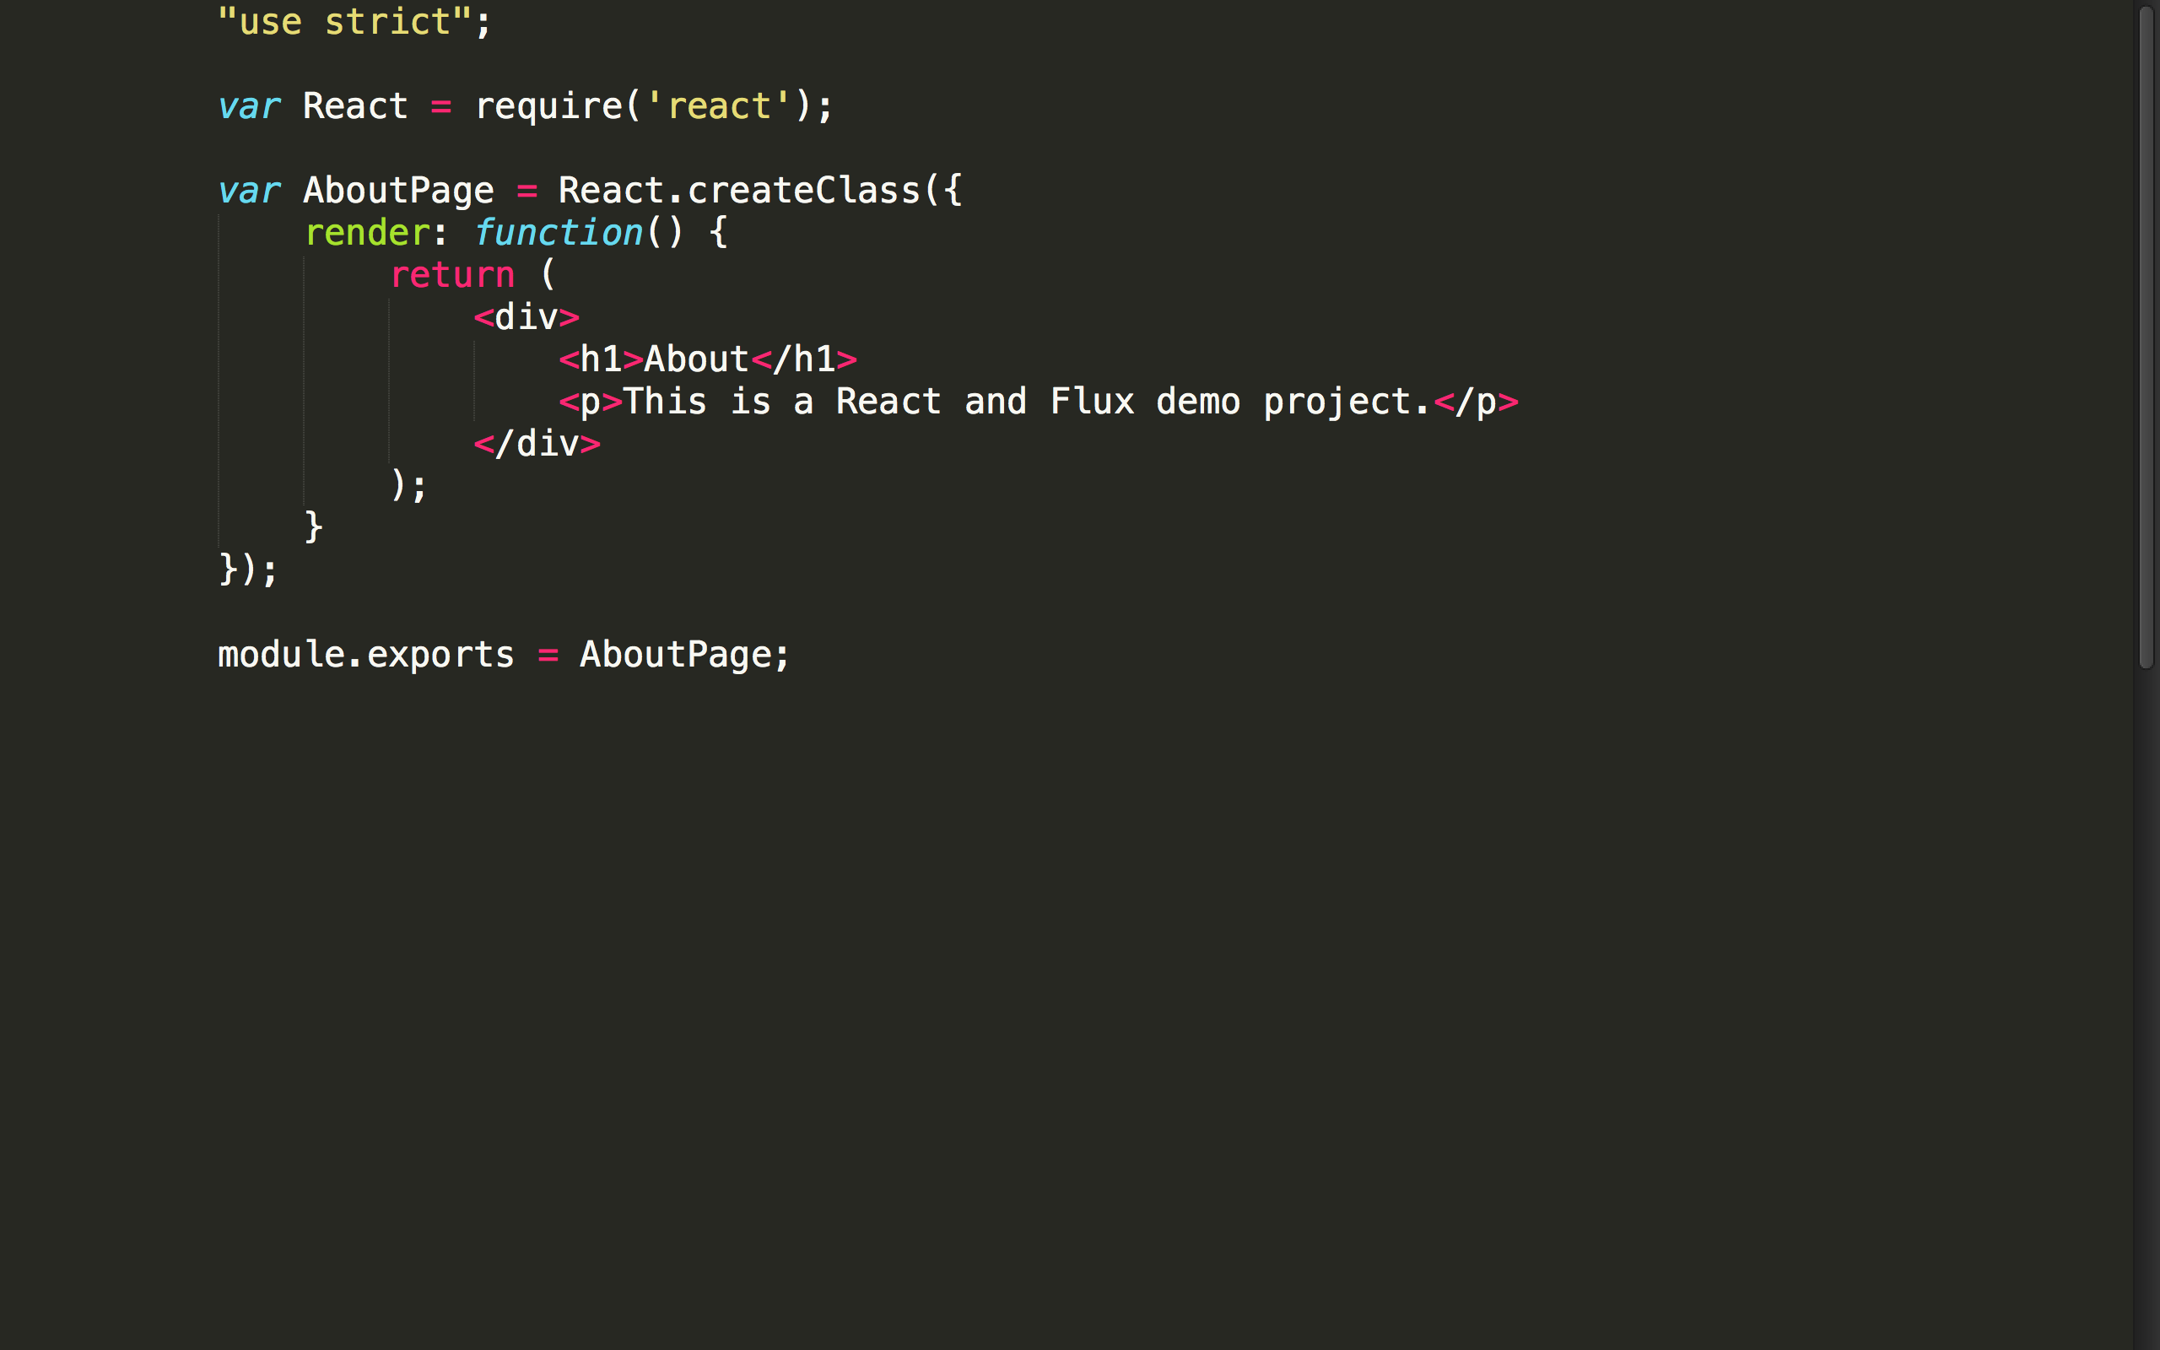

Slide 40


Slide 41
JSX
“HTML” in JavaScript
Compiles to JavaScript
Differences: className, htmlFor
Optional
Notes:
React uses an optional XML-like syntax called JSX for markup. It looks almost identical to HTML. That’s why I put quotes around HTML. It’s not actually HTML, but has a nearly identical in syntax.
There are some minor differences such as using the className instead of class and htmlFor instead of for.
Of course, a browser wouldn’t know what to do with JSX, so JSX compiles down to plain JavaScript. So really, JSX is an abstraction over plain old JavaScript calls.
Thus, JSX is totally optional. You can use JavaScript to declare your markup if you prefer, but it’s recommended to use JSX because it’s much easier to read, more approachable for designers, and more concise.

Slide 42
JSX Compiles to JS
<h1 color="red">Heading here</h1>
React.createElement("h1", {color: "red"}, "Heading here")
Notes:
Here’s a quick example of JSX. As you can see, the JSX on the top looks like HTML. As I mentioned on the previous slide, there are only a few minor differences like using className instead of class and htmlFor instead of for.
And this JSX compiles down to plain old JavaScript. As you can see it becomes a call to React.createElement. The function is passed the name of the tag you created, an object that specifies the attributes you’d like to set, and finally, the markup that should sit inside. This final parameter will contain calls to other elements if you have nested markup.
So yes, you can avoid JSX if you want to do it the hard way and write this JavaScript yourself. But it’s harder to read, takes more time to type, and is much less friendly to designers, so I recommend using JSX.
XML has the benefit of balanced opening and closing tags. This helps make large trees easier to read than function calls or object literals.

Slide 43
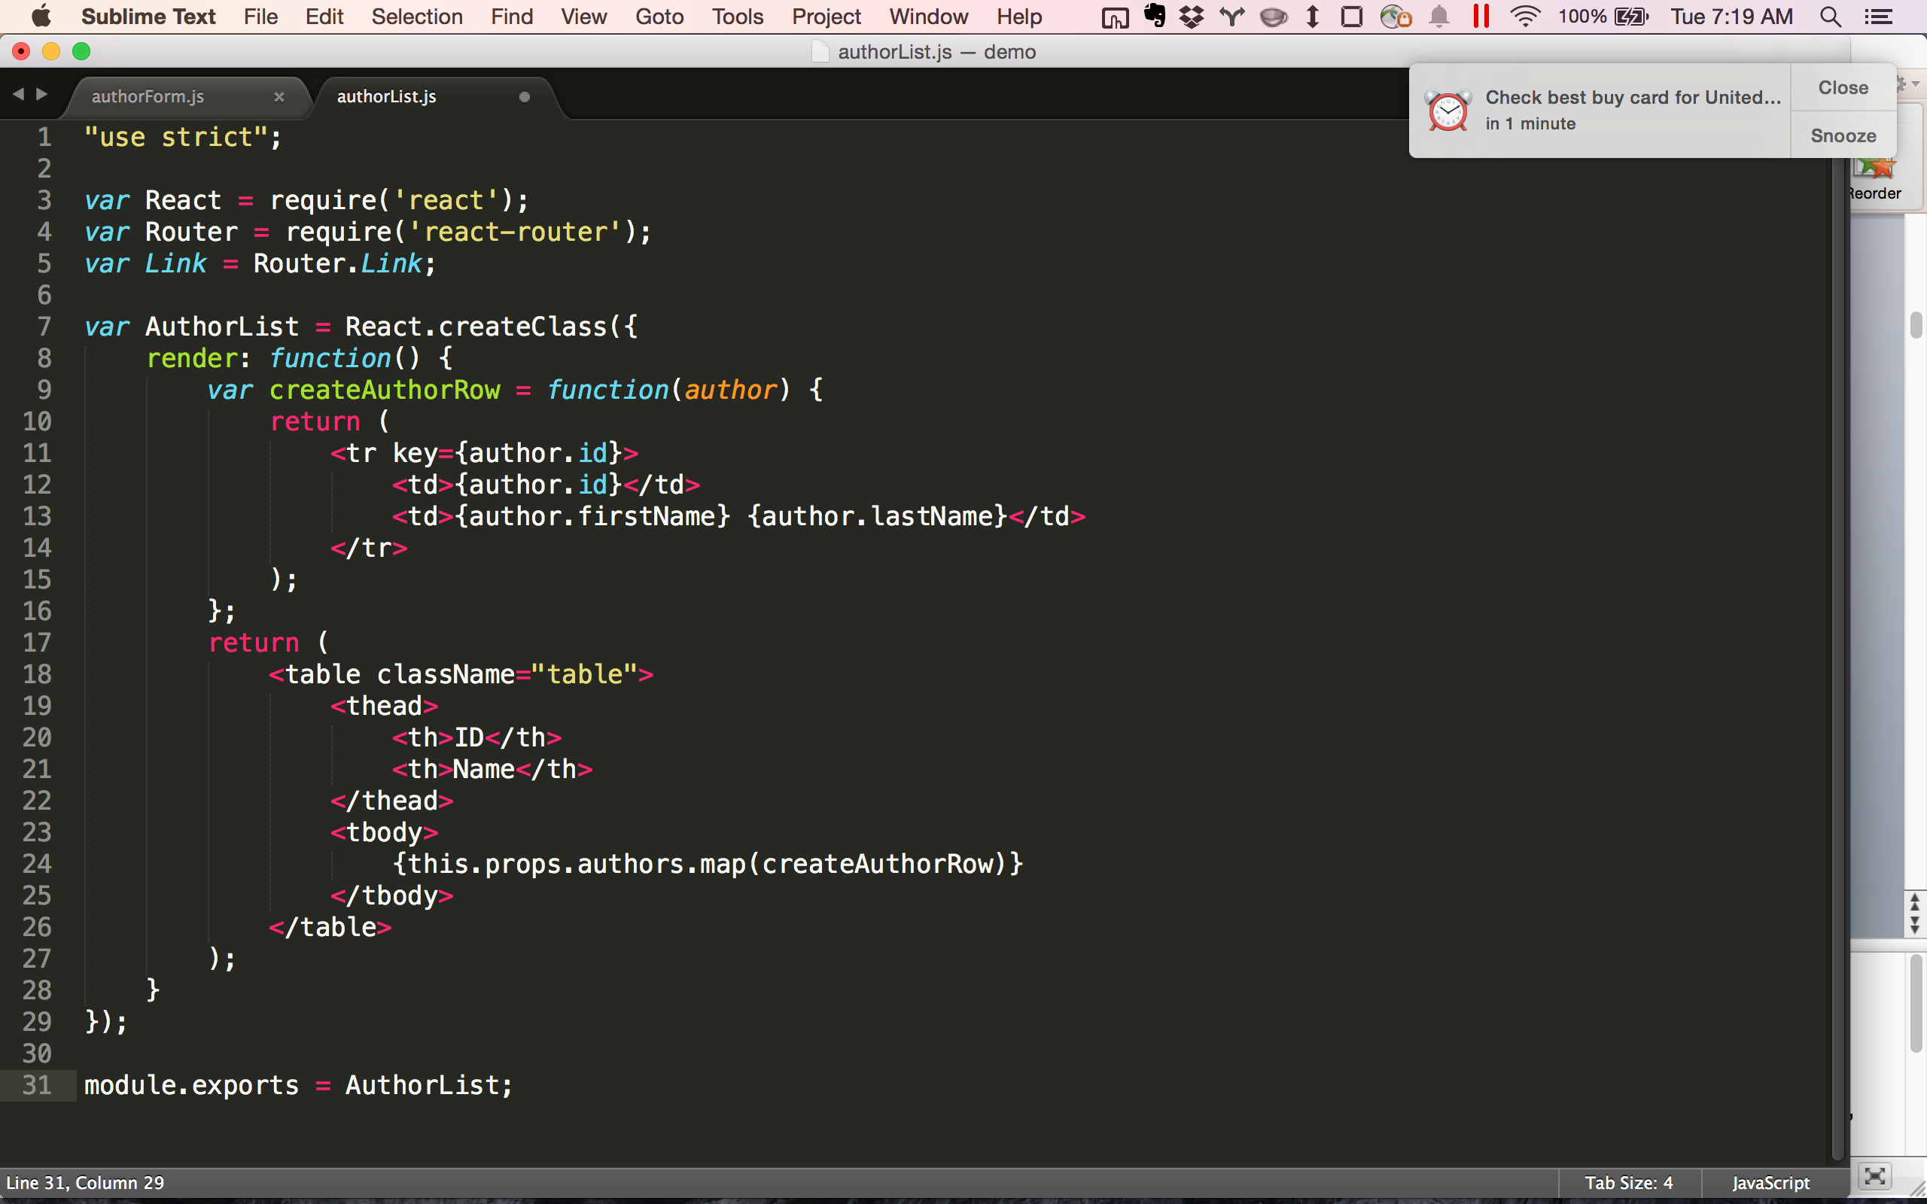
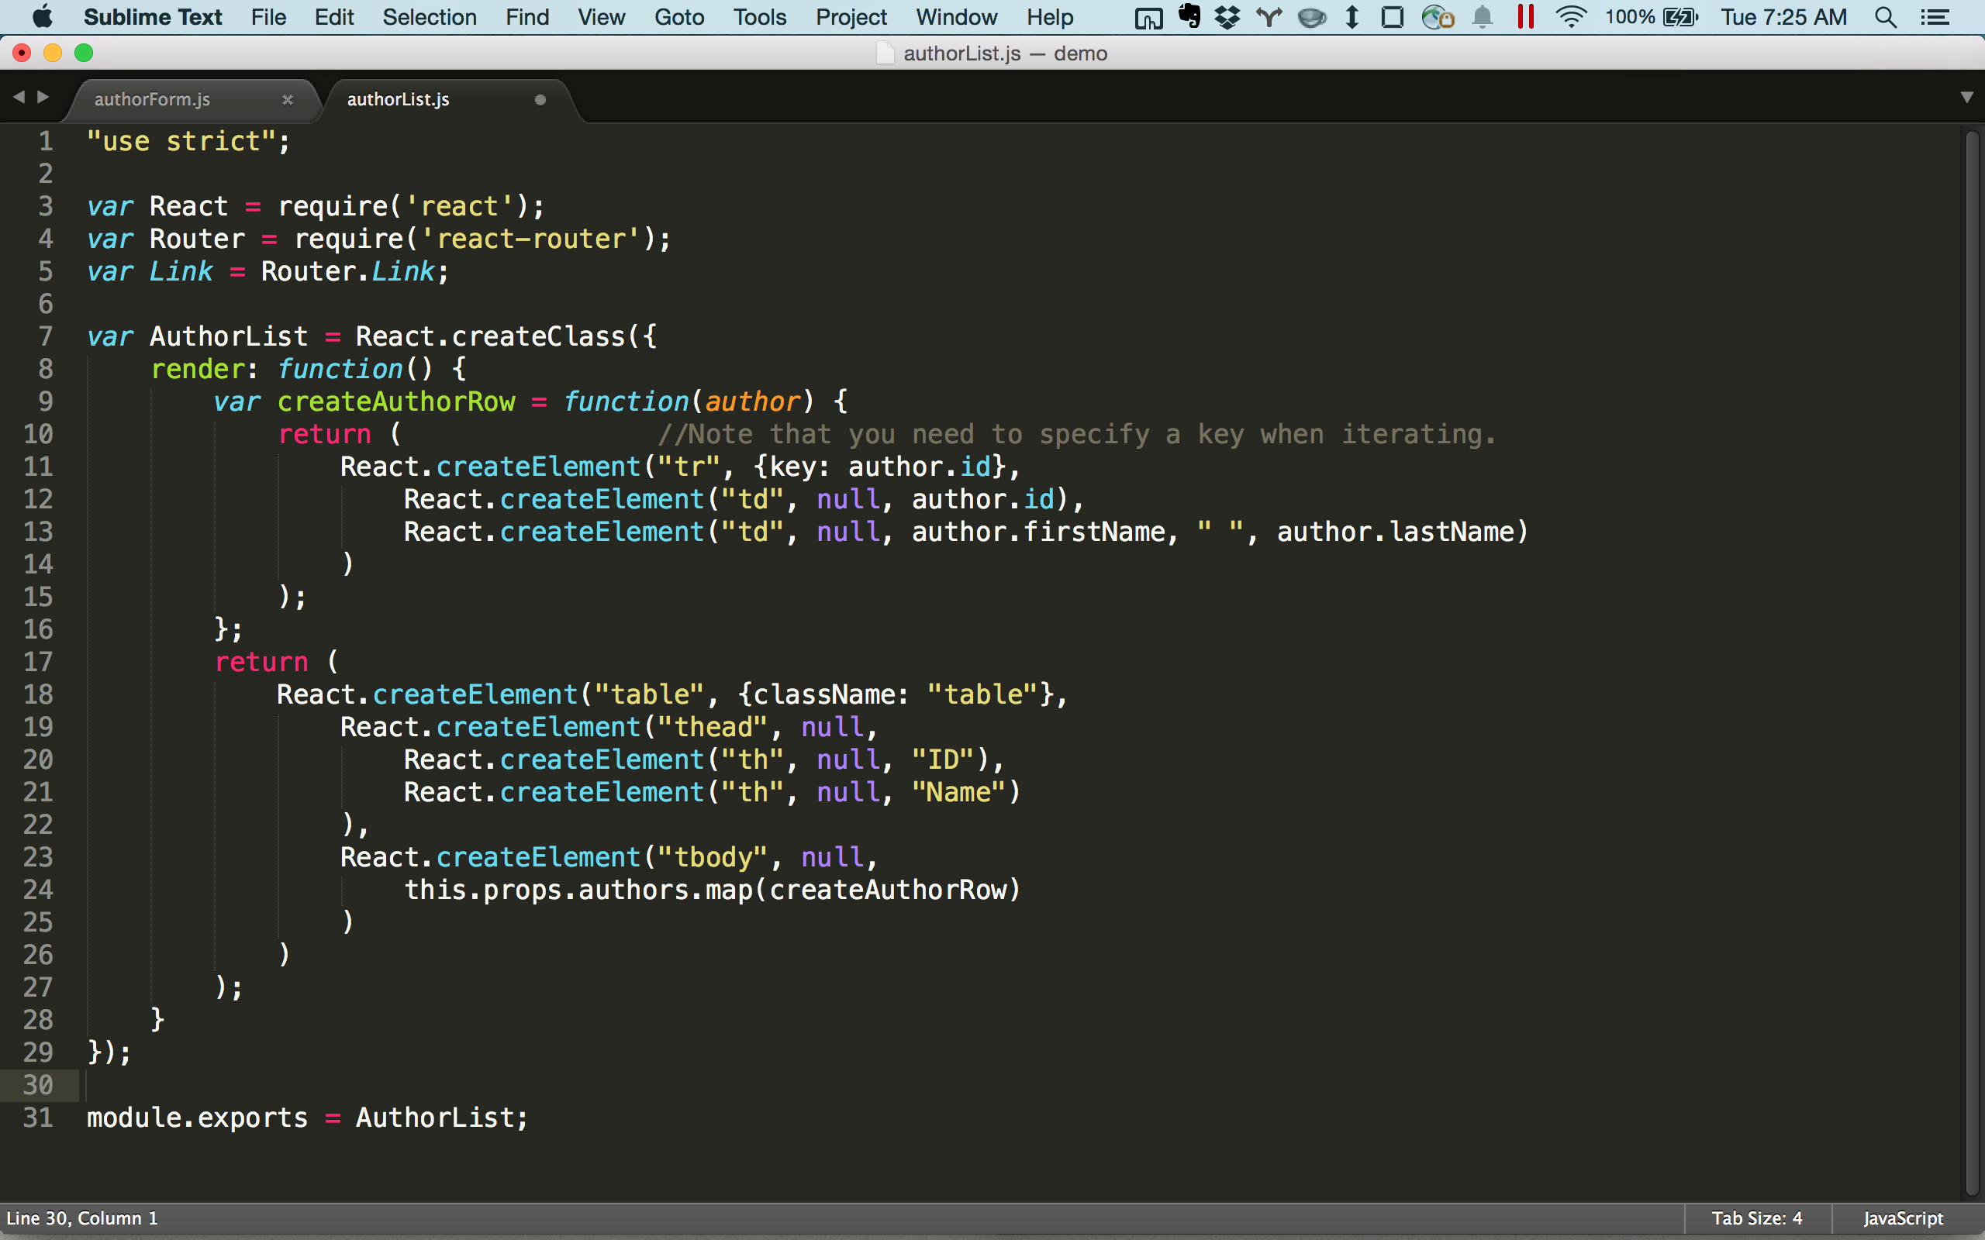
Notes:
Note that the brace matching nature of JSX makes it much easier to read and understand than the raw JavaScript. It’s less clear to spot a missing closing tag with raw JavaScript since it’s simply a parenthesis.

Slide 44
What about separation of concerns?
Notes:
Now the idea of putting HTML in your JavaScript may seem really wrong to you at first. Doesn’t think totally ignore the separation of concerns? Well let’s explore that concern for a moment.

Slide 45
“JS” in HTML
<div ng-repeat="user in users">
{{#each user in users}}
data-bind="foreach: users">
“HTML” in JS
{users.map(createUserRow)}
Notes:
Ember uses handlebars style to put “JS” in HTML: http://guides.emberjs.com/v1.11.0/templates/displaying-a-list-of-items/
Instead of putting JS in your html, put html in your JS. Instead of patching your html with ng-ifs and ng-repeats you map your props in a little component.

Slide 46



Notes:
By the way, you pronounce the one on the right “gif”.

Slide 47


Must stay in sync.
No explicit interface!
Notes:
In most server-side languages, we have the luxury of using strongly typed interfaces
Insert pic of conjoined twins here.

Slide 48
Separating intertwined concerns hinders debugging
Notes:
In most server-side languages, we have the luxury of using strongly typed interfaces
You don’t have that in JS and HTML. Instead you have run time errors. You have typos that often fail in cryptic ways.

Slide 49
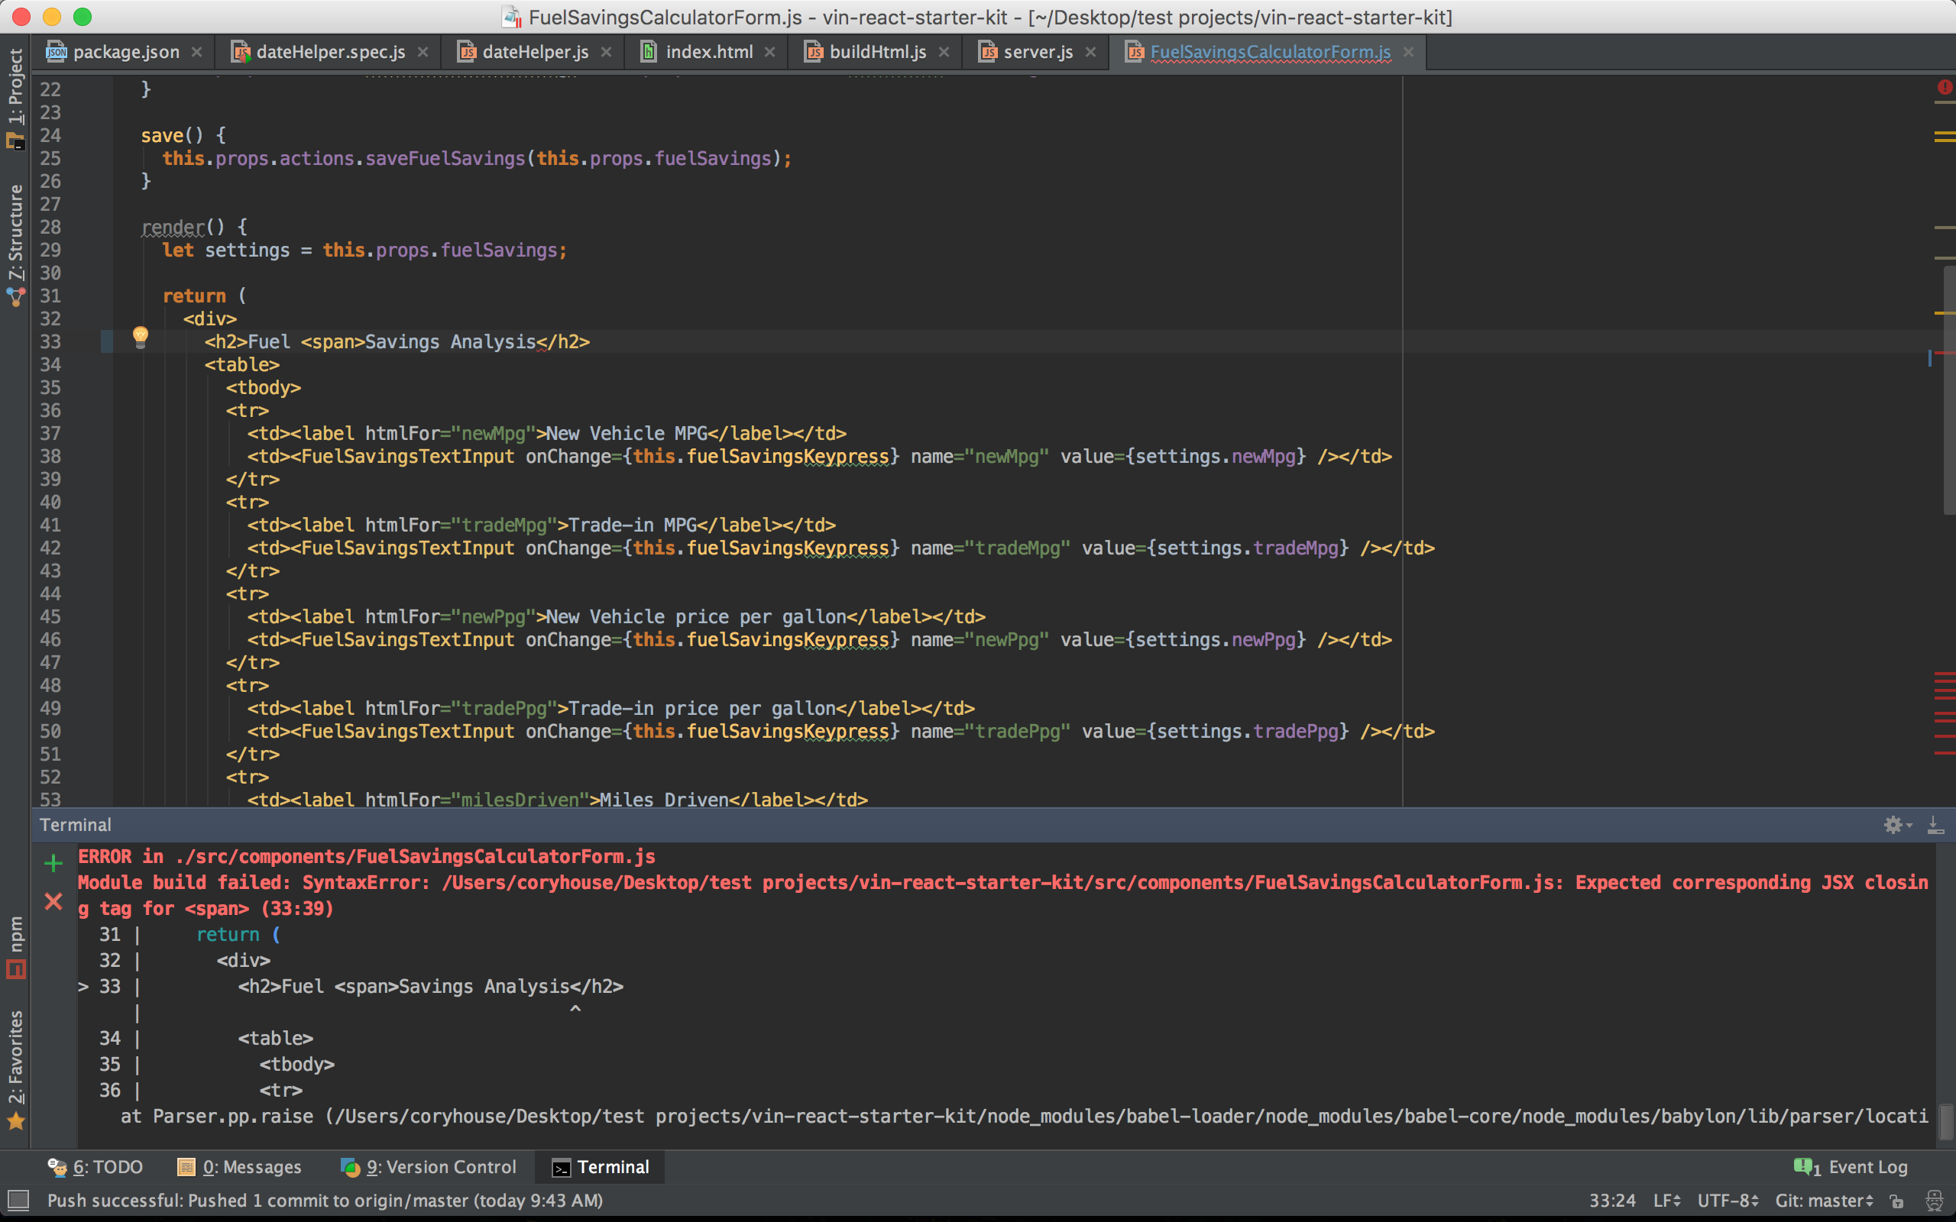
Compile-time error checking FTW!

Slide 50


Slide 51
M
V
C
Notes:
You’re likely familiar with the traditional MVC Model. MVC stands for model view controller. ASP.NET MVC utilizes this pattern. Popular client-side frameworks like Angular are called MV* or MVW since the traditional controller doesn’t really exist.
React doesn’t dictate how you handle data flows, routing, or other concerns in your application. It focuses solely on being a simple, composable component library. Its this simplicity that makes React such a powerful and flexible solution to component based application development,
Now people say React is the V in MVC…

Slide 52
M
V
C
Notes:
In actuality, well composed React components fulfill both the V and the C in MVC. As you’ll see, with React you create controller views which end up operating a lot like controllers that you’re used to in MVC.
Controller view is basically a fancy term for React views that handle data concerns and compose other dumb components together. We’ll check out an example of this in a future clip, but in short, Controller views promote reuse and separation of concerns.
Why container components/Smart and dumb, fat/skinny, stateful/pure components?
Reuse
Explicit data structure requirements via props
Separation of concerns. Data-fetching and rendering are separate concerns.
When you write dumb components that do nothing more than take in props and render html, you can easily reuse those components throughout your app.
You can think of container components as app adapters. Dumb components just plug into the container components. This way components are app independent, reusable, and easy to recompose in different configurations for different needs and apps.
Related posts:
Container components: https://medium.com/@learnreact/container-components-c0e67432e005
Smart vs dumb: EXCELLENT BULLETED LIST OF ATTRIBUTES: https://medium.com/@dan_abramov/smart-and-dumb-components-7ca2f9a7c7d0
Example Gist: https://gist.github.com/chantastic/fc9e3853464dffdb1e3c

Slide 53




JSX Friendly Editors
Notes:
One quick note before we jump into code. Since JSX isn’t JavaScript, if you use an editor that doesn’t know about JSX, you’re not going to get proper code coloring. And you’re likely to see a lot of squiggly lines under your JSX because the editor will interpret the JSX as an ugly typo. So if you choose to use JSX with React, you’ll want to use an IDE that provides support for the JSX syntax. Thankfully, there’s a variety of options:
SublimeText has a JSX plugin
JetBrain’s WebStorm comes with JSX support built-in in its latest release
Adobe’s Brackets
GitHub’s Atom editor offers a package that adds JSX support. If you use the Atom editor, go to install packages and search for React.
Visual Studio 2015 is also expected to offer JSX support, but at the time of this recording, the Visual Studio 2015 hasn’t been officially released.
If you use Visual Studio, you’ll likely want the console app extension so you can quickly open the command line from the current directory: https://visualstudiogallery.msdn.microsoft.com/4e84e2cf-2d6b-472a-b1e2-b84932511379
Throughout this course I’m going to use SublimeText because it’s popular, fast, and cross-platform. Sublime isn’t free, but you can download a full-featured trial for free. It will occasionally display a nag screen, but otherwise works just like the paid version. The sublime text plugin is at
There’s a long list of complimentary React tools at https://github.com/facebook/react/wiki/Complementary-Tools

Slide 54
Virtual DOM

Slide 55

Notes:
Imagine I show up each day and show my idiot stage hand a picture like this. It shows the setup I need for lighting on the stage. Since the lighting setup is generally the same from day to day, the most efficient thing for him to do is to compare my desired setup to the current setup. I likely want nearly the exact same setup, but without this one light. Or with this light added. But what if he doesn’t even try comparing the current setup to the desired setup? Then instead he ends up tearing things down and rebuilding them blindly based on my picture. A lot of work is lost. And setting up all these lights is a lot of time-consuming work! Manual setup is slow!
In the same way, the virtual DOM saves times. Because updating the DOM is slow, React’s virtual DOM compares the current state of the DOM to the new desired state and determines the most efficient way to update the DOM.
---other metaphors:
Imagine you had a room, and every time you wanted to add a poster to the wall, you had to repaint the whole wall.
Stage with a blue taped x on it. Idiot installs a whole new floor with the tape in one spot. Here's Jimmy, the world's dumbest stage hand. Put Angular logo on his t-shirt.

Slide 56
Why Virtual DOM?
Updating the DOM is expensive
Notes:
In today’s two-way binding libraries like Angular and Knockout, when a piece of data changes, the UI is redrawn. However, updating the DOM is an expensive operation. And by expensive, I mean it requires a lot of CPU because redrawing large section of the DOM is inefficient. React recognized this problem, which is why they created an abstraction over the DOM called the virtual DOM. React monitors the values of each components state. When a component’s state changes, React compares what the existing DOM state to what the new DOM should look like. It then determines the least expensive way to update the DOM. This sounds complicated, but it’s all behind the scenes. There’s nothing extra you have to do to enjoy the performance benefit. When you update the state of a component, it happens automatically.
This approach avoids layout thrashing, which is when a browser has to recalculate the position of everything when a DOM element changes. Being efficient is increasingly important in a world where more people are using mobile devices. Mobile devices vary widely in their CPU power, and conserving battery life is a concern as well.

Slide 57
The Virtual DOM
Without Virtual DOM
With Virtual DOM
Blindly update DOM using new state.
Compare DOM’s current state to desired new state.
Update the DOM in the most efficient way.
Notes:
The comparison happens in memory, so it’s very fast.

Slide 58
Removing a Row…
Redraws entire table
Removes the row
Notes:
Traditional frameworks say “Oh, looks like this array has changed. I’ll just iterate over the entire array and redraw everything. React, instead compares the old state to the new state to determine the cheapest way to make the change. So React simply removes the row from the DOM. Much less expensive than redrawing the entire thing.

Slide 59
Hard to argue with the results…

Slide 60
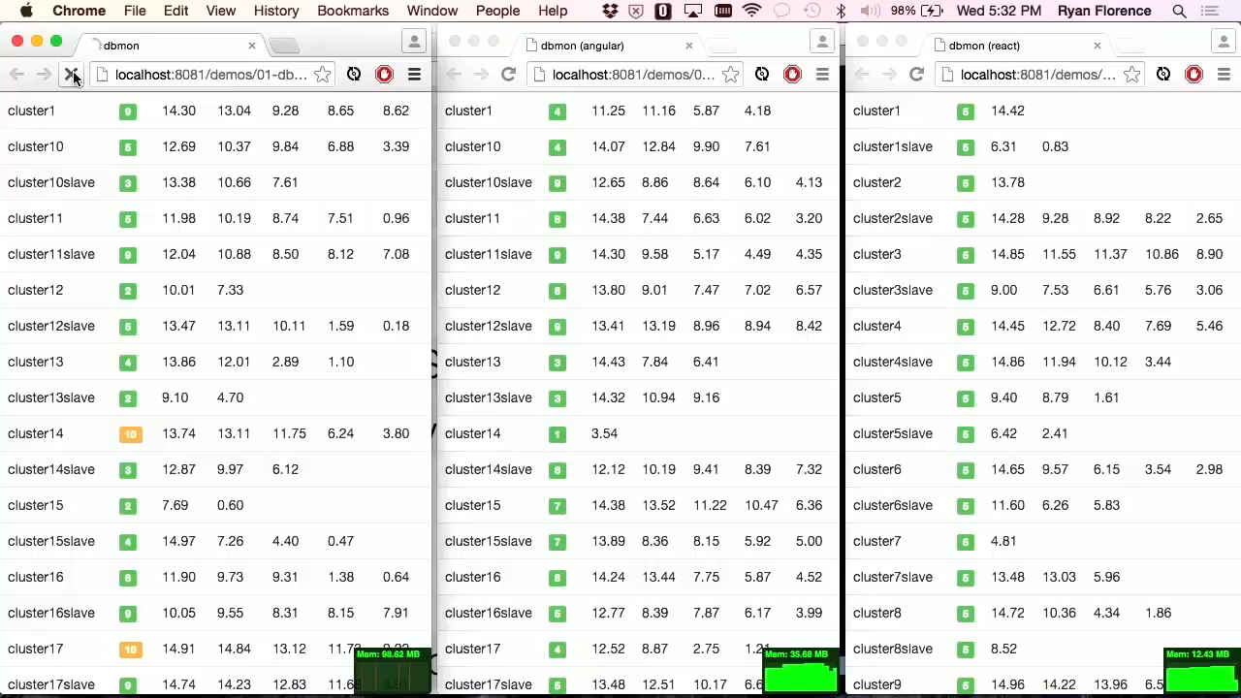
Performance
Notes:
Show Ryan Florence head to head video – From 2:50 at https://www.youtube.com/watch?v=z5e7kWSHWTg
Interactive examples:
http://speed.examples.500tech.com/ngrepeat/before/angular.html
Note that his “after” which uses Angular’s track by still isn’t as fast as React out of the box.
http://speed.examples.500tech.com/ngrepeat/after/angular.html
http://speed.examples.500tech.com/ngrepeat/before/react.html

Slide 61
Performance
Notes:
Show Ryan Florence head to head video – From 2:50 at https://www.youtube.com/watch?v=z5e7kWSHWTg
Interactive examples:
http://speed.examples.500tech.com/ngrepeat/before/angular.html
Note that his “after” which uses Angular’s track by still isn’t as fast as React out of the box.
http://speed.examples.500tech.com/ngrepeat/after/angular.html
http://speed.examples.500tech.com/ngrepeat/before/react.html

Slide 62
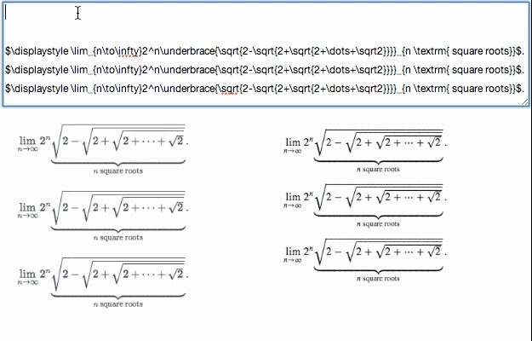

Notes:
Khan academy moved from Backbone to React. Notice how much smoother the React version renders.
This graphic shows how React (bottom left) and Backbone (bottom right) behave when a computationally expensive operation (converting raw text to a fancy math equation) is performed:
Note that the Backbone version (bottom right) is choppy, whereas the React version (bottom left) is smooth. This is because React is only persisting the deltas on each keystroke to the DOM, but Backbone is rendering everything from scratch on a change.

Slide 63
Performance: Go Even Faster
shouldComponentUpdate
PureRenderMixin + immutability
Notes:
Can go even faster with shouldComponentUpdate.
Immutability – for quick (reference level) comparisons within ShouldComponentUpdate
Or use PureRenderMixin (React component won’t update at all after initial render)

Slide 64
Meh, my app is fast enough.

Slide 65


Half second delay -> 20% drop in traffic.
Delayed in increments of 100 milliseconds
Even very small delays resulted in substantial drops in revenue.
Notes:
Maybe you say meh, my framework is fast enough.

Slide 66

Notes:
Now you may think a lot of that is just contrived and overblown. Sure, there are differences, but you have to create really extreme examples to see them. To me, it’s showcasing fundamental efficiency. The only way you can do the kind of extreme demo that React just did is by being efficient. And efficiency matters. It means better battery life. It means we start at a much more efficient foundation, so we’re less likely to need to worry about performance problems at all. It means we’re not wasting resources.

Slide 67
Virtual DOM: More Than Performance
Synthetic Events
Isomorphic Support
React Native
Hot Reloading

Slide 68
Let’s code our first components!

Slide 69
Here’s the Plan
Time to start coding!
Create our first React components
Setup custom routing
Create centralized layout
Discuss naming conventions

Slide 70
Naming React Files
ChatApp.react.js
ChatApp.jsx
chatApp.js
Notes:
When naming React files, there’s no required standard. I prefer to keep all my React components stored under a folder called components. But the filename that people use for components varies.
Imagine I created a component called ChatApp. Facebook’s examples typically put the word react in the filename, so they would call that file ChatApp.react.js. Some people prefer to use the jsx extension to clarify that there’s jsx inside the file. Others simply name the file camelCase. I find this final option preferable. Let’s consider the merits of using a .js vs .jsx extension.

Slide 71

Which Extension?
.js | .jsx
All IDEs will at least highlight JS Default application/icon Require statements assume JS Doesn’t distinguish JSX from JS Lies about contents May confuse IDE highlighting | Some IDEs won’t highlight any syntax No default application/icon Must use .jsx extension to require Distinguishes JS from JSX Clarifies content IDE knows to parse & color as JSX
Notes:
When creating React components, you might be torn like I was about whether to use a .jsx or .js extension for your component files. As you can see both approaches have some unique benefits.
With the js extension, all IDE’s should provide code coloring for your JavaScript. However, if you choose a jsx extension, some IDEs that don’t have built in jsx support or the necessary plugins installed, won’t provide any syntax highlighting. Some IDEs will have no idea what a JSX file is and therefore all text will be the same color. Already most popular IDEs either provide built in support for JSX, or provide a plugin or extension to add the support so thankfully this is rarely an issue. So the winner here is the .js extension.
When you use a .js extension, your Operating System will recognize the file as JavaScript and will associate the file with a default application and provide a useful icon. Files with a .jsx extension may be unrecognized by your OS which means your files will have no icon or associated application by default.
The require statements that you’ll place at the top of each file to reference your components will assume you’re requiring a .js file by default. This means if you use a jsx extension for your components, you’ll need to type that jsx extension in each require statement.
So far, .js looks like the way to go. But there’s some advantages to using a .jsx extension as well.
The jsx extension makes it clear that a React component using the jsx syntax sits inside. This can help people understand the content of your files without having to open the file. This risk of confusion is minimized by placing your React components together in the same directory.
So the JSX extension clarifies the file’s contents. Since JSX isn’t valid JavaScript, you could say using a .js extension is lying about the files contents.
Finally, using a .js extension may confuse some editors who need to see the JSX extension to know how to handle and syntax highlight the file. However, with the editors I’ve used so far, working with .js files hasn’t been a problem.
All things considered, I prefer to use the .js extension, so that’s the convention I’ll use throughout the course. Facebook uses a .js extension as well. That said, a number of people prefer to use a .jsx extension, so it’s really up to you. Just be sure that you’re consistent.
Relevant convo: https://github.com/facebook/react/issues/832

Slide 72
React Lifecycle

Slide 73
Here’s the Plan
Props
State
Dynamic child components
Lifecycle functions
Demo time!
Mock API
Dynamic components

Slide 74
Props and State
Props – Look like HTML attributes, but immutable
this.props.username
State – Holds mutable state
this.state.username
Notes:
Data for a given React component is held in two places:
Props
State
Props is short for properties. You can think of properties a lot like HTML attributes. Props allow you to pass data down to child components. For example, if I had a component that displayed a username, a parent component could pass down a username prop. Props are immutable – since they’re passed down from the parent, they’re effectively owned by the parent.
State, in contrast, is mutable. Since state is mutable, you should strive to only utilize state on your controller views. In other words, only use state on the top level component. Pass data down to child components via props.

Slide 75
Initial State
getInitialState
Notes:
You can optionally define a getInitialState function. In this function you can set the initial state for your component. This should typically only be done in your top level component, also known as your controller view.

Slide 76
Default Prop Values
getDefaultProps
Notes:
You can define default values for properties on your component using the getDefaultProps method. Inside this method you can return the set of properties that your component should use by default if the parent component doesn’t declare a value.

Slide 77
Lifecycle Methods
componentWillMount
componentDidMount
componentWillReceiveProps
shouldComponentUpdate
componentWillUpdate
componentDidUpdate
componentWillUnmount
Notes:
If you’ve ever worked with ASP.NET WebForms, then surprisingly, this aspect of React components will feel very familiar to you. Each React component has a lifecycle, so there’s a list of functions that allow you to hook into various parts of the component’s lifecycle. Let’s quickly explore when and where each of these lifecycle functions are called, and consider why each is useful. We’ll also consider where each of these functions run. Since React was built from the ground up to be rendered on both client and server, some of these functions run on both the client and server, while some run only on the client.

Slide 78
componentWillMount
When
Before initial render, both client and server
Why Good spot to set initial state
Notes:
componentWillMount run immediately before initial rendering.
So this function is a great spot to set your component’s initial state.

Slide 79
componentDidMount
When
After render
Why Access DOM, integrate with frameworks, set timers, AJAX requests
Notes:
componentDidMount runs immediately after render.
By the time this function is called, the component’s DOM exists. So this is a handy spot for integrating with other frameworks such as third party component libraries. This is also a good spot to set timers and make AJAX requests since you now know the component is rendered in the DOM.

Slide 80
componentWillReceiveProps
When
When receiving new props. Not called on initial render.
Why Set state before a render.
Notes:
componentWillReceiveProps runs when the component is receiving new properties. In other words, when properties have changed.
This is a place set state before the next render since this runs just before the new properties are received.

Slide 81
shouldComponentUpdate
When
Before render when new props or state are being received. Not called on initial render.
Why Performance. Return false to void unnecessary re-renders.
Notes:
shouldComponentUpdate runs immediately before render when new props or state are being received by your component.
The big reason this function is useful is for performance. Why? Well, sometimes props and/or state change but the component doesn’t actually need to re-render because the data change doesn’t effect the DOM. When this is the case, you can return false from this function to avoid an unnecessary render call.

Slide 82
componentWillUpdate
When
Immediately before rendering when new props or state are being received. Not called on initial render.
Why Prepare for an update
Notes:
componentWillUpdate runs immediately before rendering when new props or state are being received.
This function is a useful time to prepare for an update, but take note that you can’t call setState in this function.

Slide 83
componentDidUpdate
When
After component's updates are flushed to the DOM. Not called for the initial render.
Why Work with the DOM after an update
Notes:
componentDidUpdate is invoked immediately after the component's updates are flushed to the DOM.
This function allows you to operate on the DOM immediately after the component has been updated and re-rendered in the DOM.

Slide 84
componentWillUnmount
When
Immediately before component is removed from the DOM
Why Cleanup
Notes:
The final lifecycle function is componentWillUnmount. This function runs just before a component is unmounted from the DOM.
So this is a great place to cleanup by destroying any related resources or DOM elements that were created when the component was mounted.

Slide 85
Keys for Dynamic Children
Add a key to dynamic child elements
<tr key={author.id}>
Notes:
When you’re creating multiple child components dynamically, it’s important to provide a key for each child component. As children are added and removed, React uses the key to assure child components are properly reordered or destroyed.
So in this example I’m using the author’s id field as the key. This is often the primary key for the corresponding database record, but it need not be. You just need to declare a unique id for each specific record.

Slide 86
Summary
Props Pass data to child components
State Data in controller view
Lifecycle Handle bootstrapping and third party integrations
Notes:
Great, we now have the author page successfully displaying dynamic data from our mock API.
Let’s wrap up this module by reviewing some of the new concepts we put to use.
Props give us an elegant way to pass data to child components that looks a lot like HTML attributes.
And state is how we handle component data in our controller views. We’ll use React‘s state more in the next clip as we refactor what we just built into a controller view to provide better separation of concerns and reuse.
The various lifecycle methods give us many options for bootstrapping our components and provides clear hooks for integrating React with third party libraries.
Now it’s time to discuss controller views. As you’ll see in the next module, this pattern will help us create simple reusable components in React by creating separating our markup and data marshalling concerns.

Slide 87
Composing Components

Slide 88
Here’s the Plan
Our focus: Composition
Controller views
Prop validation via PropTypes
Mixins

Slide 89
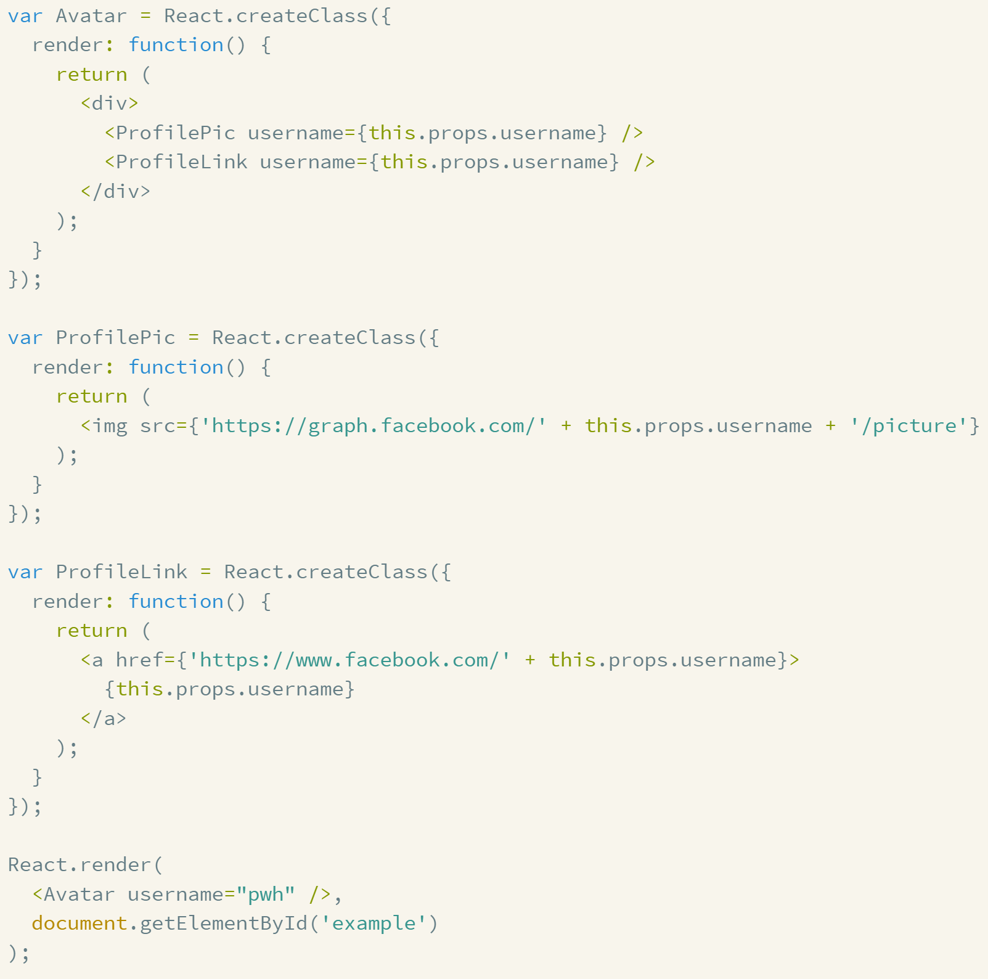
Composition
Notes:
React makes it trivial to compose components together. It’s fundamental to the way React scales and the simplicity of composing components is one of React’s greatest features. This simple example from the React docs is pretty hard to beat. As you can see, an Avatar is simply composed of two other components, ProfilePic and ProfileLink. You simply reference the child components within the parent component. Nice and simple!
Also, there’s an important concept of ownership at play here. The Avatar component owns the ProfilePic and ProfileLink components here. By ownership, I mean the Avatar component is setting the props for these components. And since a component can’t mutate it’s properties, they remain set to whatever value the owner sets them to. And this leads us to the concept of controller views.

Slide 90
Controller Views
Top level component
Sets props on children
Interacts with stores
Notes:
**NOTE: This slide is copied from the React module, but need to mention here too.**
To clarify, a controller view is simply a React component that has child components. At first I found this jargon confusing. Why am I using the term controller view here instead of just calling it a React component? Well, controller views are a name for the top level React component.
A React controller view controls the data flows for all its child components. It does this by setting props on child components.
And as you’ll see in the Flux module, controller views interact with Flux stores.
But don’t let the name controller view confuse you. It’s simply the top level component on the page. You can nest components as deeply as you like. But it’s recommended to have a single top-level controller view that interacts with the store and passes all necessary data down to the children.
Although it’s possible to nest controller views, it’s not recommended to do so since it can cause multiple data updates and cause React’s render method to get called multiple times.

Slide 91
Controller Views
Notes:
Let’s check out a demo of creating controller views by refactoring our AuthorPage component.

Slide 92
Prop Validation
propTypes: {
author: React.PropTypes.object.isRequired,
onSave: React.PropTypes.func.isRequired,
validate: React.PropTypes.func.isRequired,
errors: React.PropTypes.object,
hasErrors: React.PropTypes.func.isRequired,
},
Notes:
PropTypes are a great way to be explicit about the data you expect to see in your component’s properties. You can specify that certain properties are required and also specify the datatypes for each prop such as number or string, or bool.
propTypes are simply a map that lets you specify a validation function for each property. When validation fails, a warning is logged in the console.
This is an example of propType that we’re going to setup to validate that the expected properties are being passed to our author form component. So, you can see that we’re:
Requiring an author object
Requiring a function that should be called when the user clicks save
Requiring a function that should be called to validate input
Declaring the any errors passed into our form should be of type object
Requiring a function that determines if any errors have occurred.

Slide 93
Prop Validation
optionalArray: React.PropTypes.array,
optionalBool: React.PropTypes.bool,
optionalFunc: React.PropTypes.func,
optionalNumber: React.PropTypes.number,
optionalObject: React.PropTypes.object,
optionalString: React.PropTypes.string,
Notes:
As you can see, you can add validation to require arrays, Booleans, functions, numbers, objects, and strings.
Now note, for performance, propTypes are only run in development. So think of this more as a way to document your expectation and catch issues during development than as a way to enforce these rules in production.
And remember, every propType that isn’t required should have a corresponding field in getDefaultProps.
------------------
(be sure to set NODE_ENV="production" to prevent needlessly slowing down your final application. The envify Browserify transform coupled with uglify --compress is a handy way to do this.)

Slide 94
Development vs Production Mode
Minified version is for production.
Notes:
This is also a good time to mention development vs production mode. Prop validation only runs in development mode, so don’t rely on prop validation for production. The minified version of React runs in production mode by default. So be sure you deploy the appropriate version to each environment. And remember that prop validation won’t run in production.
http://stackoverflow.com/questions/22118915/how-to-turn-on-off-reactjs-development-mode

Slide 95
Prop Validation
Declare expected property types
Notes:
Let’s check out a demo of declaring expected property types.

Slide 96
Summary
Controller Views “Smart” components that pass data down via props
PropTypes Validate props
Notes:
Let’s wrap up this module by review the core API for React that we just discussed. React is a small, very focused library so there are only around a few core functions and concepts to learn.
We learned that controller views are smart components that pass data down to their children via props. We refactored the monolithic AuthorPage component so that it passes its data down to a child component via props. We called this child component authorList. So AuthorPage is now a proper controller view.
We used propTypes to specify and validate properties during development. You can specify dataTypes and whether the props are optional or required, but remember, these are only run in development mode.
Finally, we briefly touched on mixins – Mixins are a way to handle cross cutting concerns in React. When you have some behavior that you’d like to use on a large number of components, mixins give you a simple way to share that behavior across many components. We’ll put mixins to use more in the next module on react router since it ships with some handy mixins out of the box.

Slide 97
Flux

Slide 98
What is Flux?
A pattern
Centralized dispatcher
Unidrectional data flows
Notes:
Flux is not a framework. It’s really just a name for a pattern of unidirectional data flows. This is why you see so many alternative implementations of the pattern with slight tweaks.
As you’ll see, with Flux all updates to your application’s state via a centralized dispatcher that, not surprisingly, dispatches data to the application’s data stores.
This pattern enforces clear, predictable unidirectional data flows. Unlike popular two-way binding libraries like Angular and Knockout, data flows in one direction in Flux. We’ll see how this works in a moment. In short, you'll need the Flux Dispatcher, and any Javascript event library.

Slide 99
They call it Flux for a reason too.
Notes:
Remember how I joked that they call it React because it creates such strong reactions in people? I’d say the name Flux fits well because there are so many alternative implementations that are very similar in concept, but differ in various ways.
Okay, really, the name Flux makes sense because Flux deals with actions and data changes in our application.

Slide 100
Flux Implementations
Facebook’s Flux
Alt
Reflux
Flummox
Marty
Fluxxor
Delorean
Redux
NuclearJS
Fluxible
Notes:
Before we dive in, I want to clarify that this module discusses Facebook’s Flux implementation. Flux is Facebook’s name for an architectural pattern that has unidirectional data flows and a centralized dispatcher. There are many alternative implementations to Facebooks’ Flux, all with fun names including
Yahoo’s Fluxible - https://github.com/nicolashery/example-isomorphic-one
Alt
Flummox
Marty Fluxxor
Delorean and Reflux
Here’s other up and comer’s doing something similar to Redux at the bottom of this (excellent Redux overview) post: https://medium.com/@dan_abramov/the-evolution-of-flux-frameworks-6c16ad26bb31
In this module we’re going to discuss Facebook’s Flux implementation because it’s popular and battle tested in production on one of the highest traffic sites in the world. It’s also the inspiration for the other implementations that you see here. That said, you might see some things you don’t like about Flux. There’s admittedly some boilerplate and plumbing code necessary, but I will say once you get used to the pattern it’s very easy to understand and extremely scalable.
Regardless, the great news is, if you decide Facebook’s Flux isn’t for you, there’s a wide variety of Flux alternatives out there that work well with React. Generally, these Flux alternative are quite similar in philosophy and API, but in many cases require less code to do the same job, often at the expense of either clarity or flexibility.
Bottom line, once you learn Facebook’s Flux implementation, you should find it easy to contrast the alternatives above. And given the speed of open source development, you’ll likely find other alternatives not listed here.
Here’s a great link that compares these options with stats:
My top considerations:
Alt – Most downloads
Reflux – Most stars.
Isomorphic options:
Fluxible -
Flummox – Already on V3, but V4 is the last one since author says Redux is the future. No singletons or globals. Docs are an isomorphic example. Dispatcher and constants are implementation details. Uses context to pass flux instance down automatically to all components. Supposedly now deprecated in favor of Redux per comment on above github link.
Redux – Hot reloading in Flux. Not yet 1.0. By smart Adam guy who spoke at React conf.

Slide 101
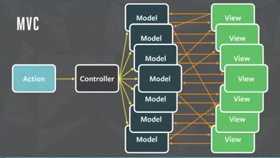
Good Luck Debugging This
Notes:
Have you ever built a large client-side application that requires interactions among multiple views and models? As applications grow, you may find the traditional MVC pattern devolves into models and views that end up interacting with one another. You may find that you need to pass data between your viewmodels. But doing so makes your application difficult to reason about and thus very unpredictable and tricky to debug. And this leads us to the sales pitch for Flux. Facebook ran into these issues and chose to utilize unidirectional data flows as a solution.

Slide 102
Two-way Binding vs Unidirectional
Action
Viewmodel
Dispatcher
Two-way binding
Unidrectional
View
Store
React
View
Notes:
Flux implements a unidirectional data flow. That sounds complicated, but it really just means data flows in a single direction. This is easier to understand by contrasting unidirectional data flows with two-way binding.
If you’ve used Angular, Ember, or Knockout, you’re already familiar with two-way binding. When you change the value of a textbox, the corresponding data behind the scenes is updated immediately. It’s quite handy and simple to understand.
In contrast, with Flux an action occurs. A dispatcher notifies any stores that have registered with the dispatcher that an action has occurred. When the store changes, the React component is updated so the user can see the updated UI. When the user interacts with a UI element, a new action occurs and this unidirectional flow starts over. This is called unidirectional because updates flow in one direction from the action ultimately to the view. Unlike two-way binding, the view doesn’t directly update state. Instead, it fires off actions which ultimately update state.
Unidirectional data-flows make the application easier to reason about because the results of a given action are easy and predictable to trace. The unidirectional flow does require some extra concepts and code, but at the benefit of clarity, testability, and predictability. So you can think of the tradeoff like this: Two-way binding is simpler conceptually and requires less typing. Unidirectional flows pay off as your application grows because it’s more explicit and makes it easy to update multiple stores when a given action occurs.

Slide 103
Flux: 3 Parts
Action
Delete User
Dispatcher
Notify everyone who cares
Store
Hold app state and logic
React
View
Notes:
You’re likely familiar with the MVC pattern. The MVC pattern uses models, views, and controllers which interact with one another. React combined with Flux is a very different approach so try to ignore anything you know about MVC. Flux is a totally different way of thinking about data flows. Flux seems complicated at first, but to understand Flux you really just need to learn three new concepts that we saw on the previous slide: Actions, Dispatchers, and stores.
Actions describe user interactions that occur in your React components. So for example of an action, the user may click a button.
These actions are handled by a centralized dispatcher. The dispatcher is a singleton registry, but that sounds more complicated than it is. It’s really just a centralized list of callbacks. So the dispatcher makes calls to stores.
Stores hold your application’s data. And not surprisingly, the data in the stores are updated, your React view reflects the new data. This is a unidirectional flow. In other words, the UI never updates the data directly. Updates to the UI are ultimately rendered because of changes to the store.
Now this likely sounds confusing at first. I know it did to me. Let’s look at some charts and see if that helps.

Slide 104
Actions
Action
Encapsulate events
Triggered by user interactions and server
Passed to dispatcher
Dispatcher
Store
React
View
Notes:
Actions encapsulate specific events that occur within the application. An action might be SaveUser, DeleteItem, etc.
The dispatcher exposes a method that allows us to trigger a dispatch to the stores, and to include a payload of data, which is called an action.
Action creators (dispatcher helper methods) describe all actions that are possible in the application.
Actions are typically triggered in two places:
First, when a user interacts with the user interface, the view will call the appropriate action. Typically, action creator functions are grouped together in files that have related actions. For example, a PluralsightCourse Actions file would contain a list of action creators related to Pluralsight courses like createCourse, RateCourse, etc. Action creator methods add a type that is stored in a constants file. This type is used by the dispatcher to properly handle the action and pass updates to related stores.
The second place actions are triggered is from the server, such as on page load or when errors occur during calls to the server.

Slide 105
Actions
Action
Payload has type and data
{
type: USER_SAVED
data: {
firstName: ‘Cory’,
lastName: ‘House;
}
}
Dispatcher
Store
React
View
Notes:
Action payloads have a common structure of a type and data.
So this is an example of an action that occurs when a user is saved. As you can see, it has a type of USER_SAVED and it returns data consisting of the user first and last name. So action payload sounds complicated, but it’s really just this simple structure. Of course, the data will vary depending on the action, but every action payload has a type and data.

Slide 106
Dispatcher
Action
Central Hub – There’s only one
Holds list of callbacks
Broadcasts payload to registered callbacks
Sends actions to stores
Dispatcher
Store
React
View
Notes:
All data flows through the dispatcher as a central hub. The dispatcher is a singleton, so there is only one dispatcher per app.
The dispatcher, not surprisingly, dispatches things. What does it dispatch? Actions. Stores register with the dispatcher so that they can be notified when data changes. So the dispatcher simply holds a list of callbacks.
The dispatcher invokes the callbacks that have been registered with it and broadcasts the payload that it receives from the action. This effectively dispatches the actions to the relevant stores. This centralized dispatcher design creates a single point where multiple stores can request updates when a given action happens. This makes the application's data flow predictable. Each action updates specific stores based on the callbacks that are registered with the dispatcher.
So basically, the dispatcher distributes actions to the stores. The dispatcher exists to help get messages from views to stores. Your views will respond to a different kind of event.

Slide 107
Constants
Keeps things organized
Provides high level view of what the app actually does
Notes:
While we’re discussing dispatchers, I should also mention constants. With Flux, it’s helpful to create a constants file. This file helps keep things organized by defining constants that are used throughout the system in a centralized place.
As you’ll see, It also serves as a handy high level view of all the things the app actually does.

Slide 108
Store
Action
Holds app state, logic, data retrieval
Not a model - Contains models.
One, or many
Registers callbacks with dispatcher
Uses Node’s EventEmitter
Dispatcher
Store
React
View
Notes:
Stores are the place where our application’s data is stored. Stores hold application state, logic, and data retrieval methods.
However, a store isn’t a model like you’d think about in traditional MVC. Instead, a store contains models. This will make more sense in a moment when we look at an actual example of a store.
Your application can have a single store, but as your app gets larger, you may find it useful to create multiple stores. This helps keep related data grouped together in well named stores. And since Flux has a unidirectional data flow using a centralized dispatcher, you can rest assured that the proper stores will be updated for each event that occurs in your user interface.
Stores get updated because they have callbacks that are registered with the dispatcher. Remember, the Flux dispatcher keeps track of all the stores that would like to be notified when an action occurs in your application. Only your stores are allowed to register dispatcher callbacks! Your React components should never call AppDispatcher.register.
Finally, as you’ll see, Flux stores are extended with Node’s EventEmitter. This allows our stores to both listen to and broadcast events. It also allows our React components to update based upon those events. Our React components listen to our Stores. Stores emit changes using Node’s EventEmitter so This is how our React components find out that our application state has changed. So the react components that use a store’s data are redrawn when the state changes.
In summary, stores are just what they sounds like: A centralized place where the application’s state and logic is stored. Stores have no direct setter methods. Instead, they only accept updates via callbacks that are registered with the dispatcher. So these callbacks say “Hey dispatcher, when something changes, let me know about it”. And this is a key concept: The store is the only thing in your application that knows how to update data. This is the most important part of Flux. The event we dispatched doesn't know how to add or remove items. Only the store knows how.
Finally, an app can have one store, or if you find it helpful, you can create multiple stores that are specific to a given domain or portion of the app. So, for example, if you build an app that sells cars, you might have a carStore, a dealership store, a salesman store, etc. If two stores do somehow relate with one another, the dispatcher manages that relationship and keeps the two stores from calling each other directly. Again, this makes the application data flow highly predictable and easy to trace and test.
When stores are updated, they must emit a change event so that the relevant React components know that a change to a store has occurred.
NOTE: need to choose between these 3 styles of creating a stores and dispatchers by “extending” Node’s EventEmitter:
1. var merge = require('react/lib/merge'); see scotch.io/tutorials/getting-to-know-flux-the-react-js-architecture
2. his style which uses object-assign: generator-flux-react

Slide 109
The Structure of a Store
Every store has these common traits (aka interface)
Extend EventEmitter
addChangeListener and removeChangeListener
emitChange
Notes:
You’ll notice that when we implement multiple stores there’s a common shape to the store structure. These functions are the core interface that you always implement.
You extend eventEmitter so that your store can emit events to tell your React components that data has changed.
You expose a methods for adding and removing changeListeners. This let’s you easily say “I want this React component to know when this store changes”.
And finally, you need a method to actually emit the change.
Of course, if you want to avoid this duplication, you can use your choice of design patterns to refactor it out, but for simplicity we’ll leave these in each of the stores that we implement in our example application.

Slide 110
{
type: USER_SAVED
data: {
firstName: ‘Cory’,
lastName: ‘House;
}
}
Dispatcher
Payload
User Store
Address Store
Product Store
Notes:
Now remember, there may be multiple stores in a complex application. For example, you may decide to store your user, address, and product data in separate stores. And this is a great example of where unidirectional data flows in Flux really shine. In this case, the dispatcher will still send the payload to all three of the stores so that they’re aware of any actions that have occurred which might update the store’s data. And remember, the dispatcher always dispatches the same payload. The payload has a type and data. The type tells the store what action just occurred so that it can respond accordingly.

Slide 111
As an application grows, the dispatcher becomes more vital, as it can be used to manage dependencies between the stores by invoking the registered callbacks in a specific order. Stores can declaratively wait for other stores to finish updating, and then update themselves accordingly.
Flux Documentation
Notes:
As I mentioned earlier, the Flux pattern admittedly requires extra code. You have to register callbacks with the dispatcher which is certainly a bit of extra work. But as your application grows, this explicit one way data flow is really helpful.
<read quote>
This quote is a reference to the waitFor API that is part of Flux. This API allows you to specify the order that your stores are updated for a given action. This is useful when there are dependencies between your stores.

Slide 112
I usually view ActionCreators as something that is used for writes to the server. For example, the user added a new message by clicking the Send button, so the responsible view calls into ActionCreator. On the other hand, if a store needs to fetch data from the server, then that doesn't have to use an ActionCreator. Instead, the store can directly hit an endpoint to load its data, and then direct the response through the dispatcher.
Jing Chen, Facebook
Notes:
Source: https://groups.google.com/forum/#!topic/reactjs/jBPHH4Q-8Sc

Slide 113
Controller Views
Action
Top level component
Interacts with Stores
Holds data in state
Sends data to children as props
Dispatcher
Store
React
View
Notes:
We discussed the concept of controller views a bit in the React module, but I want to mention it again here because it has implications when working with Flux as well.
React has the concept of a controller view. This is the top level component that often ends up composing child components. At first I found this jargon confusing. Why am I using the term controller view here instead of just calling it a React component? Well, controller views control the data flows down to all child components, so the name controller view actually makes a lot of sense.
I mention controller views again here because they’re the components that should interact with stores. When a store emits an update, the controller view should receive the update and thus pass the updated data down to its children. The child components are automatically updated via their props.
Remember, controller views hold data in state and send data to children as props. In React you can nest components as deep as you like. But it’s recommended to have a single top-level controller view that interacts with the store, holds data in state, and passes all necessary data down to the children. It’s helpful to just pass a single large object down to all children via properties so you don’t have to change code in multiple places as new properties are added to data objects in the future.
Although it’s possible to nest controller views, it’s not recommended to do so since it can cause multiple data updates and cause React’s render method to get called multiple times which hurts performance. So it’s recommended to have a single top level controller view per page, or a single controller view for each major portion of the page. This means all child component simply receive data from the parent component via props. This is how we wired up our components in the previous module that introduced React.

Slide 114
Action
User clicked “Save User” button…
Web API
Send Action
Payload
Payload sent to dispatcher
Dispatcher
Payload:
{
type: USER_SAVED
data: {
firstName: 'Cory',
lastName: 'House';
}
}
Checks for registered callbacks
Send Action Payload
Sends payload to all registered callbacks
Store
Receives payload
Updates storage and fires change event
Store updates and emits change event
Receives change event and re-renders
React View
Notes:
Let’s consider a more granular example.
The flow begins with an action occurring. Imagine I just click the save user button in the user interface.
This generates an action. When an action occurs, the action sends a payload to the dispatcher. The payload always has the same structure. It’s an objects with two properties: type, and data. Here’s an example of a payload that might be sent by the action if I just clicked “Save user”.
The dispatcher checks its list of registered callbacks to determine which stores should receive the payload. Remember, stores register with the dispatcher to say “hey dispatcher, when this action occurs, I want to know about it.” Since the user clicked the save user button, the payload’s type was USER_SAVED. So the dispatcher looks for any registered callbacks that care about users being saved.
And the dispatcher sends the payload that it received to all the stores that have registered callbacks for that action.
The store calls updates its internal storage based on the payload that it received. In the case of saving a user, the store will update the user’s data. If a new user was created, the user’s key would now be reflected in the dataset. Once the store is done processing the update, it emits a change event
Emitting the change event notifies React that data has changed. Now React knows that it needs to re-render the UI to reflect the new data.
Finally, of course, any new activities in the UI may generate a new action and cause this unidirectional flow to start over again.
And though I didn’t mention it earlier, actions commonly make AJAX calls to web APIs to get and receive data as well.
And that’s it. Okay, saying that’s it makes it sounds simple. I know it may not feel that way. Yes, there’s a lot of pieces which can be frustrating at first. But trust me, the clarity of being explicit and having all data flow in one direction makes even very complicated applications very predictable. Traditional two-way binding certainly saves typing, but it can become difficult to understand what the application is doing if viewmodels fire off cascading updates to other views and viewmodels. This uni-directional flow requires more typing, but once you understand these concepts, I find it creates code that is easy to navigate and reason about because it’s very explicit.
See https://scotch.io/tutorials/getting-to-know-flux-the-react-js-architecture for inspiration.

Slide 115
A Chat With Flux
React Hey CourseAction, someone clicked this “Save Course” button.
Action Thanks React! I registered an action creator with the dispatcher, so the dispatcher should take care of notifying all the stores that care.
Dispatcher Let me see who cares about a course being saved. Ah! Looks like the CourseStore has registered a callback with me, so I’ll let her know.
Store Hi dispatcher! Thanks for the update! I’ll update my data with the payload you sent. Then I’ll emit an event for the React components that care.
React Ooo! Shiny new data from the store! I’ll update the UI to reflect this!
Notes:
Okay, so we just went over the core players in a Flux application. Actions, the dispatcher, stores, and React views. That’s a lot of new concepts so it’s easy to get confused at first. I certainly found the unidirectional data flow and new concepts in Flux confusing when I first read the docs. It’s so different than anything I’ve used before. So I found it helpful to think about actions, dispatchers, and stores as three people with different roles who interact with each other. Here’s an example conversation that I played through in my head:
<read above>
Now, let’s walk through this again, but this time, so the code full screen and explain the flow again while calling out the specific code that is saying these things.

Slide 116
Flux API
register(function callback) – “Hey dispatcher, run me when actions happen. - Store”
unregister(string id) – “Hey dispatcher, stop worrying about this action. - Store”
waitFor(array<string> ids) – “Update this store first. – Store”
dispatch(object payload) - “Hey dispatcher, tell the stores about this action. - Action”
isDispatching() – “I’m busy dispatching callbacks right now.”
Notes:
As I said, Flux is really just a design pattern, so once you understand the philosophy of the pattern, there’s not much actual code to review in Facebook’s Flux. The dispatcher is a singleton that registers callbacks. These callbacks are called when actions happen in your application.
Thus the core API for Facebook’s Flux contain only 5 functions, all of which revolve around the simple idea of registering callbacks and calling them when actions occur.
The first is register. The register function accepts a callback. This is how you tell the dispatcher, when this action happens, I’d like you to call this callback.
Unregister, not surprisingly, removes a registration from the dispatcher. So this is how you would tell a dispatcher to stop calling a callback when an action occurs.
WaitFor is a way to run callbacks in a specific order. The idea here is, if multiple callbacks are registered with Flux at the same time, then you may want them to be called in a specific order. This API allows you to specify the callbacks that should be completed before continuing execution of the current callback. The registered callback that you’d like to waitFor is specified using by passing the dispatchToken of the callback you’d like to wait for to the waitFor function. This is admittedly hard to envision without an example, so we’ll look at an example in a moment.
Dispatch actually dispatches the payload to all registered callbacks. This is how an action tells the dispatcher that something happened. So basically, this is how the action says “Hey dispatcher, go tell all the stores about this action that just happened. The payload is an object with two properties: An action Type and the data itself.
Finally, isDispatching is a Boolean that is true when the dispatcher is busy dispatching things.

Slide 117
Summary
Action
Flux is a pattern for unidirectional data flows
Actions encapsulate events
Dispatcher is a central hub that holds callbacks
Stores holds app state
Many implementations
Dispatcher
Store
React
View
Notes:
So in summary, Flux is a pattern for unidirectional data flows. It’s composed of 3 core concepts:
Actions,
A Dispatcher
And Stores
Action encapsulate events such as a user clicking on a button
The dispatcher is the centralized hub. It’s a singleton, so there’s only one per app. The dispatcher holds references to callbacks so that is knows what stores to notify as actions occur.
Stores hold application state. You can have one store if your app is simple, or multiple stores if you find it helps.
And of course, once the store is updated, any react controller views that care are notified when it emits an event.
Flux has many alternative implementations that are similar to what we just discussed, but now that you know the foundational principles it should be easy to learn the alternatives.

Slide 118
Let’s code Flux!

Slide 119
Final Thoughts…

Slide 120
The Competition is Responding.

Slide 121
 | Angular 1 | Angular 2 | React
Isomorphic |  | x | x
Unidirectional |  | x | x
1 file per component |  | x | x
Virtual DOM |  | x | x
Hot Reloading |  |  | x
Browser Support | IE8 | IE9 | IE9
Pluggable |  |  | x
JSX |  |  | x
Component Syntax | 4 | 6 | 10

Slide 122
Competition Will Eventually Have All This.
Yep. But it still won’t be React.
Lightweight, fast, pluggable, isomorphic components in IE8+.
Notes:
Ember is getting “fast boot”
Ember’s new Glimpse engine (not yet released) is rumored to have performance as good as React by using similar Virtual DOM techniques.
Ember is eliminating two-way binding in future versions.
Angular is getting Isomorphic support in Angular2.
Angular 2 is supposed to be much faster as well.

Slide 123
Why React?
Fast
Pluggable
Simple
Testable
Rich Error Messaging
Composable
Broad Browser Support
Isomorphic Friendly
Battle Proven
Notes:
So why should you consider React over all the other component options out there?
React is well known for being extremely fast and responsive. React can scale to extremely large and complex Uis because it’s very efficient about how and when it manipulates the DOM. React is also designed to help you eliminate layout thrash via lifecycle methods.
Well, as you’ll see, React is easily pluggable into existing applications. Since it’s just a view layer, it can be integrated with other technologies. So sure, you can create an entire app using React for the view layer, or you can use React in certain places to try it out, or where you feel it adds the most value.
Since React is a very focused library, it’s quite simple to learn. The API is small and there aren’t very many moving parts and concepts to master.
React is easily testable since it’s highly deterministic and easily rendered to a string. You can write tests that assert a specific output given the components state by simply rendering the component to a string and comparing the result to the expected output.
React components can be easily rendered on both the client and the server because React doesn’t need the DOM to be able to render. React utilizes a virtual DOM, which makes it fast, avoids inefficient DOM manipulations, and allows React components to render without needing the DOM at all. When a component’s state changes, React compares the current state of the DOM to the new state in memory. React determines the most efficient way to update the DOM. This virtual DOM implementation helps make it isomorphic friendly.
And finally, React is used by Facebook, one of the highest trafficked and widest reaching websites in the world, as well as long list of well known websites including the BBC, the New York Times, HipChat, Flipboard, Netflix, AirBNB, and Khan Academy.

Slide 124
React Downside

Slide 125
I recently announced my solution…

Slide 126
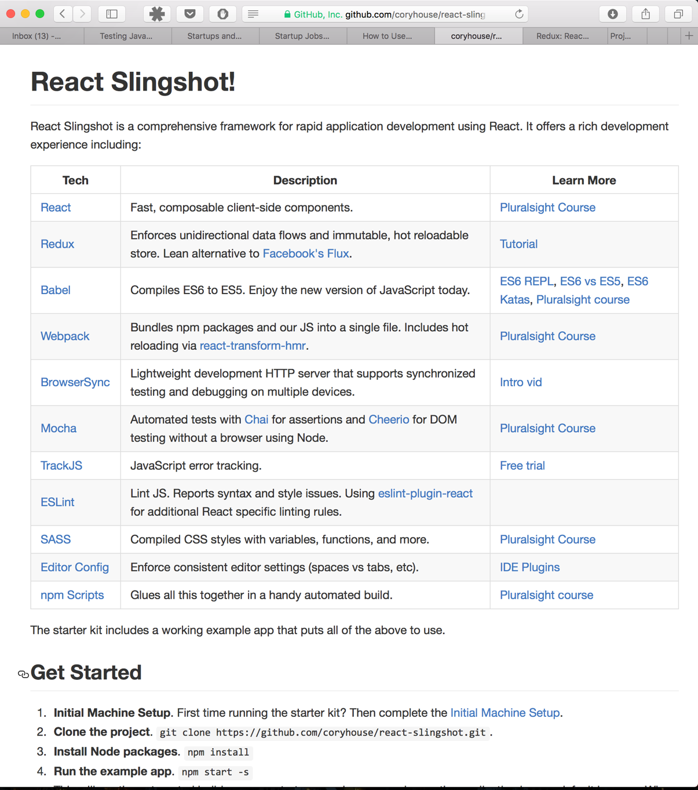
github.com/coryhouse/react-slingshot

Slide 127

There’s much more to be said...

Slide 128
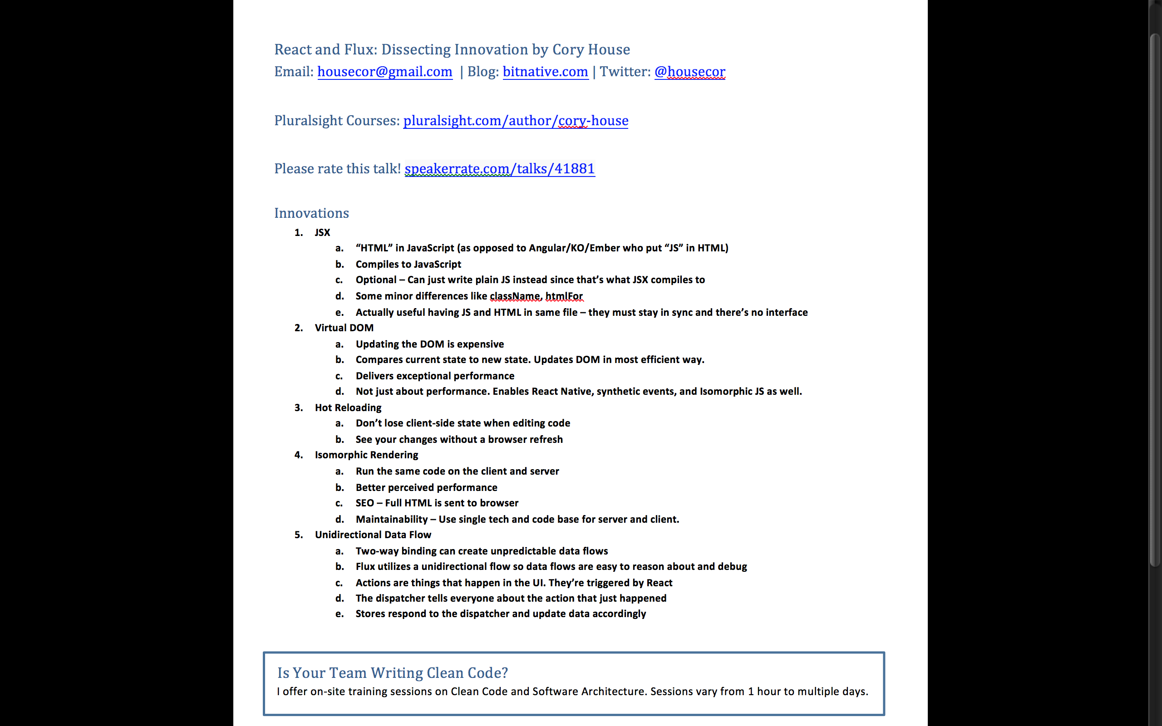
bitnative.com/handouts

Slide 129
Invitation: 5 Minute Retrospective

Slide 130



@housecor
pluralsight.com
speakerrate.com
Notes:
http://speakerrate.com/talks/65271

